Slide 1
02/04/2021

Slide 2
C1 vs C2

Slide 3
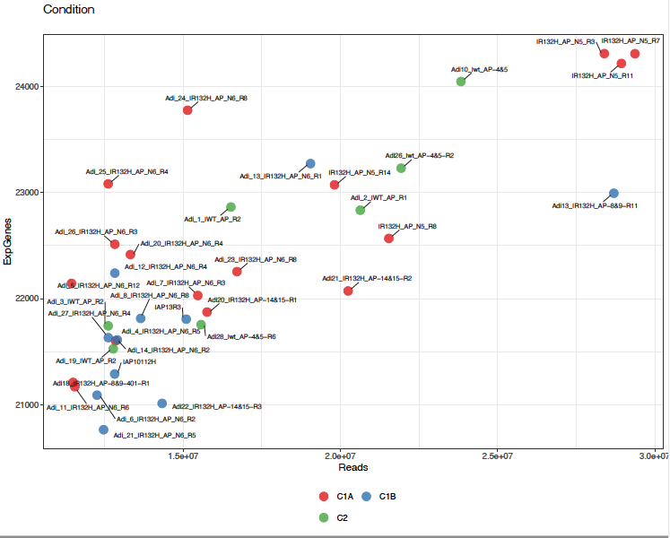
Principal component analysis C1 vs C2
-
IWT_AP_R1
IWT_AP_R3
IWT_AP_R5
Adi_9_IR132H_AP_N6_R3

Slide 4
Number of genes DEGs between C1 and C2
Analysis November 11/11/2020
qval lfc | 0.05 1 | 0.05 2 | 0.05 3 | 0.01 1 | 0.01 2 | 0.01 3 | 0.001 1 | 0.001 2 | 0.001 3 | 1e-04 1 | 1e-04 2 | 1e-04 3
DESeq2_rmv5_Adi18_10_22_CSHS15 | 5594 | 1801 | 310 | 5100 | 1668 | 260 | 4506 | 1481 | 206 | 3967 | 1306 | 151
Analysis February 02/04/2021
qval lfc | 0.05 1 | 0.05 2 | 0.05 3 | 0.01 1 | 0.01 2 | 0.01 3 | 0.001 1 | 0.001 2 | 0.001 3 | 1e-04 1 | 1e-04 2 | 1e-04 3
adi_february_2021 | 5552 | 972 | 50 | 4898 | 972 | 50 | 4011 | 972 | 50 | 3223 | 860 | 50
q.value 0.05 and lfc 1
q.value 0.01 and lfc 2
(Ceccarelli size = 2274)
(Ceccarelli size = 2274)
19%
2 %

Slide 5
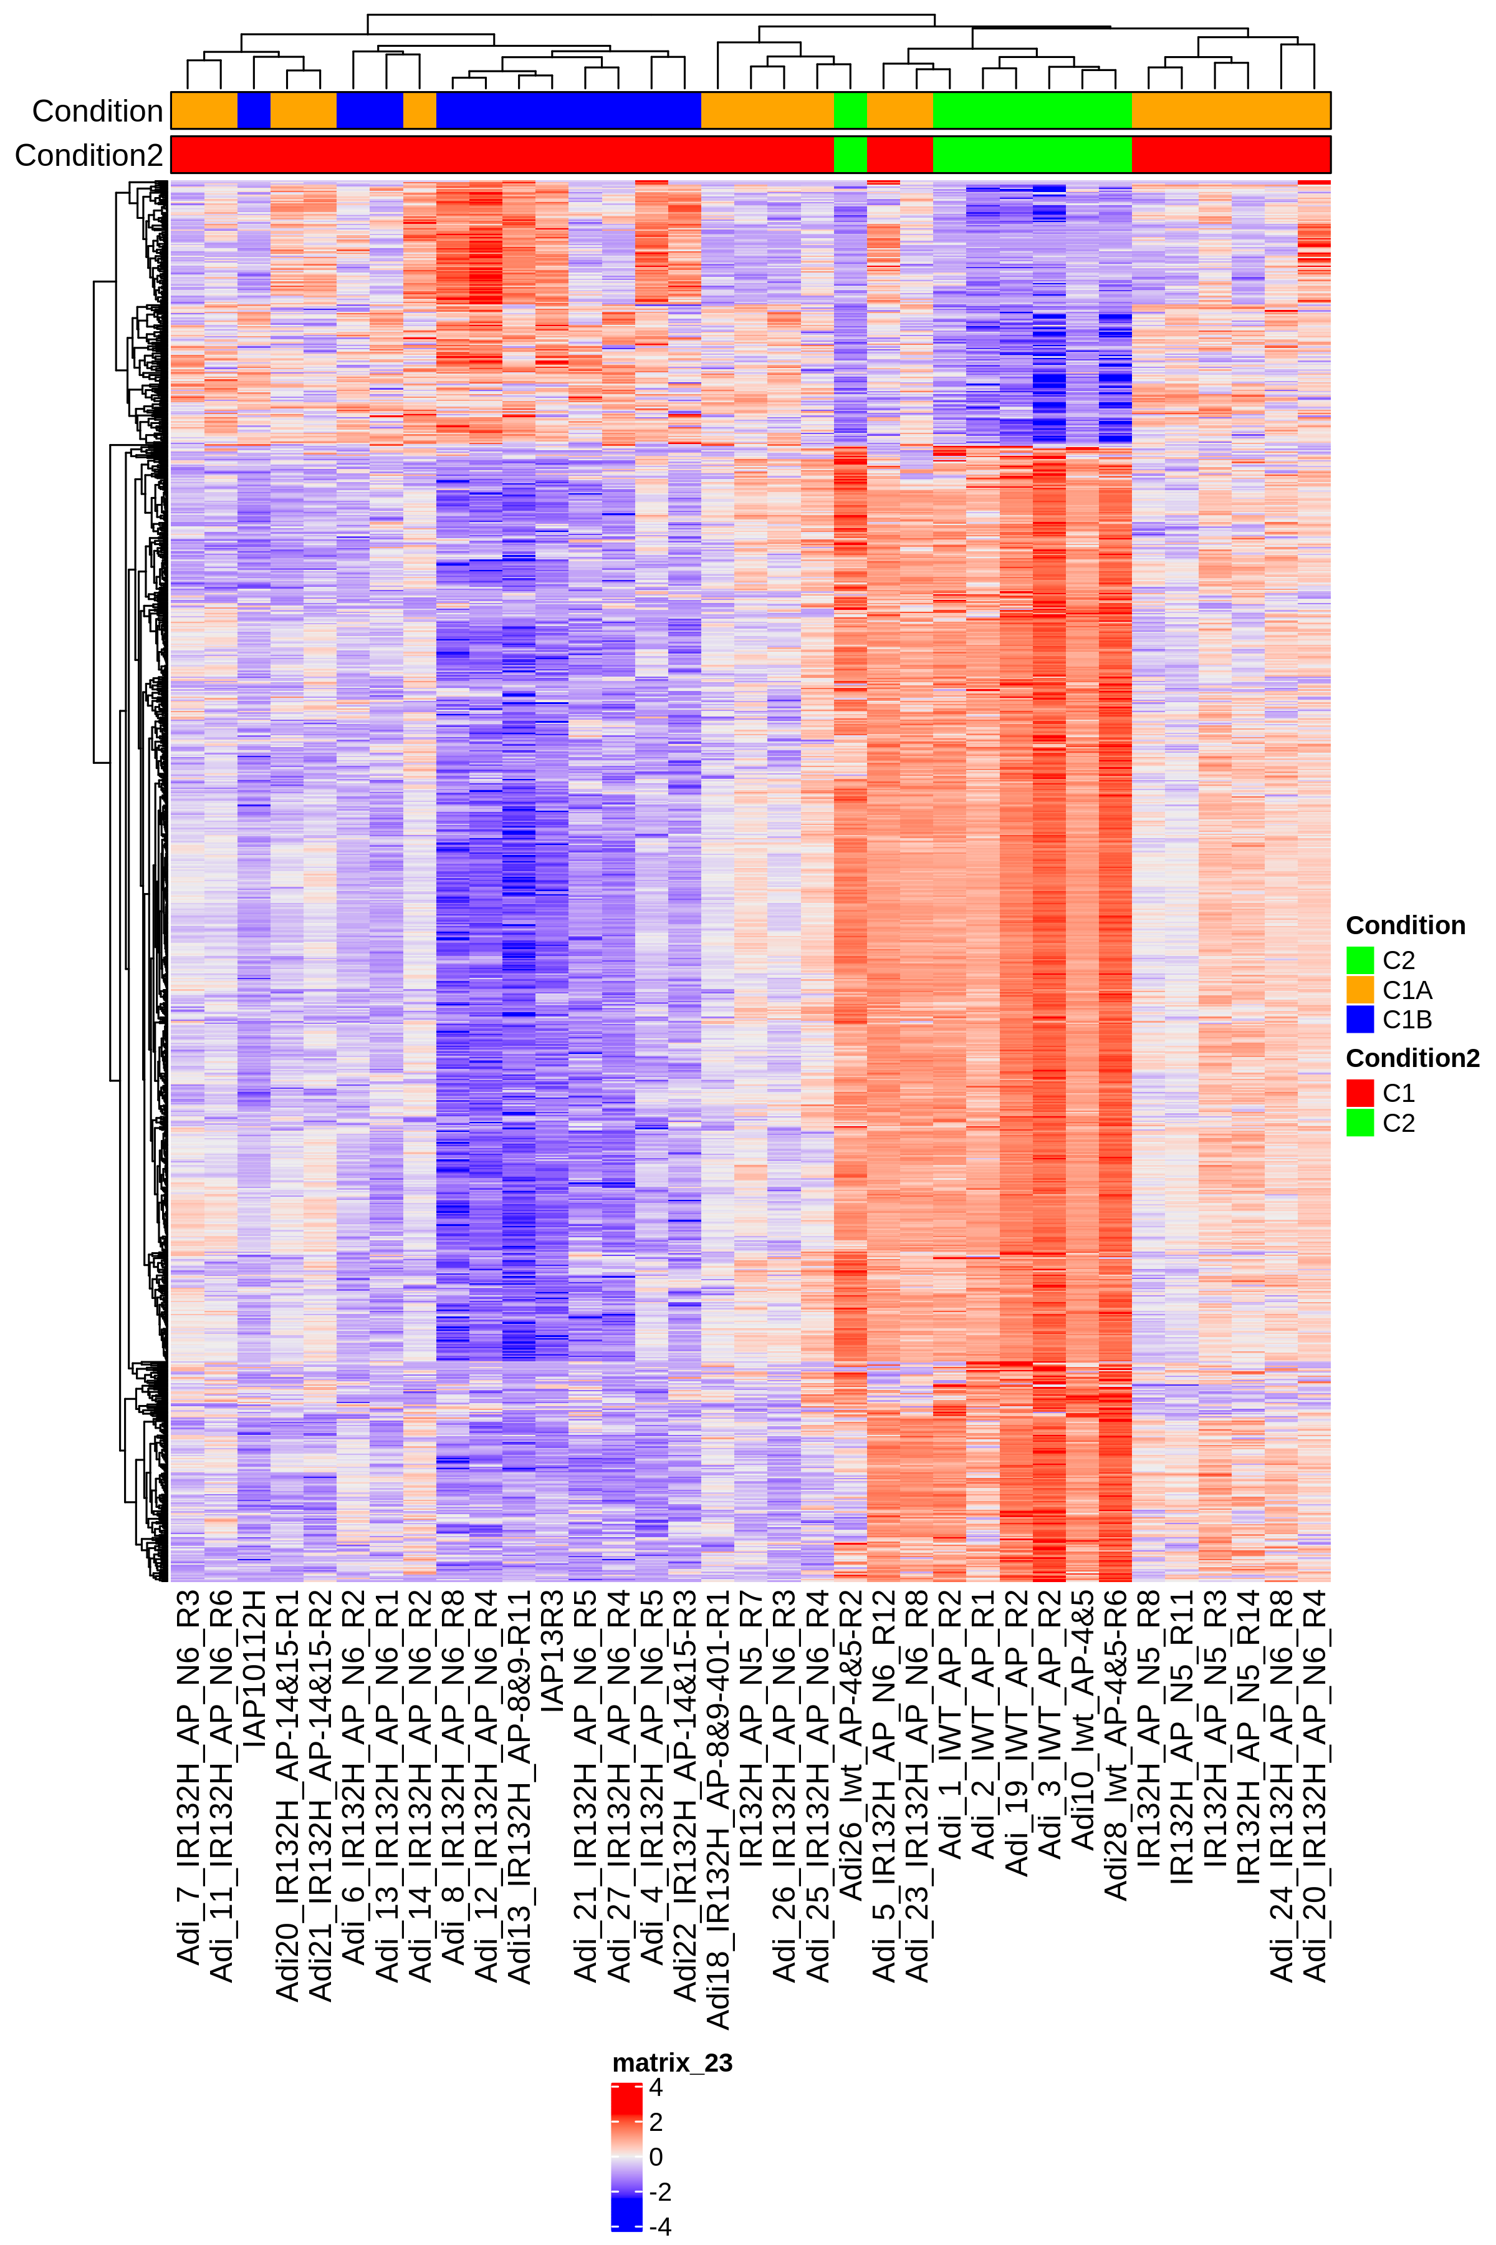
Differentially express genes between C1 vs C2 (q.value 0.01 – 2)
n. genes= 972

Slide 6
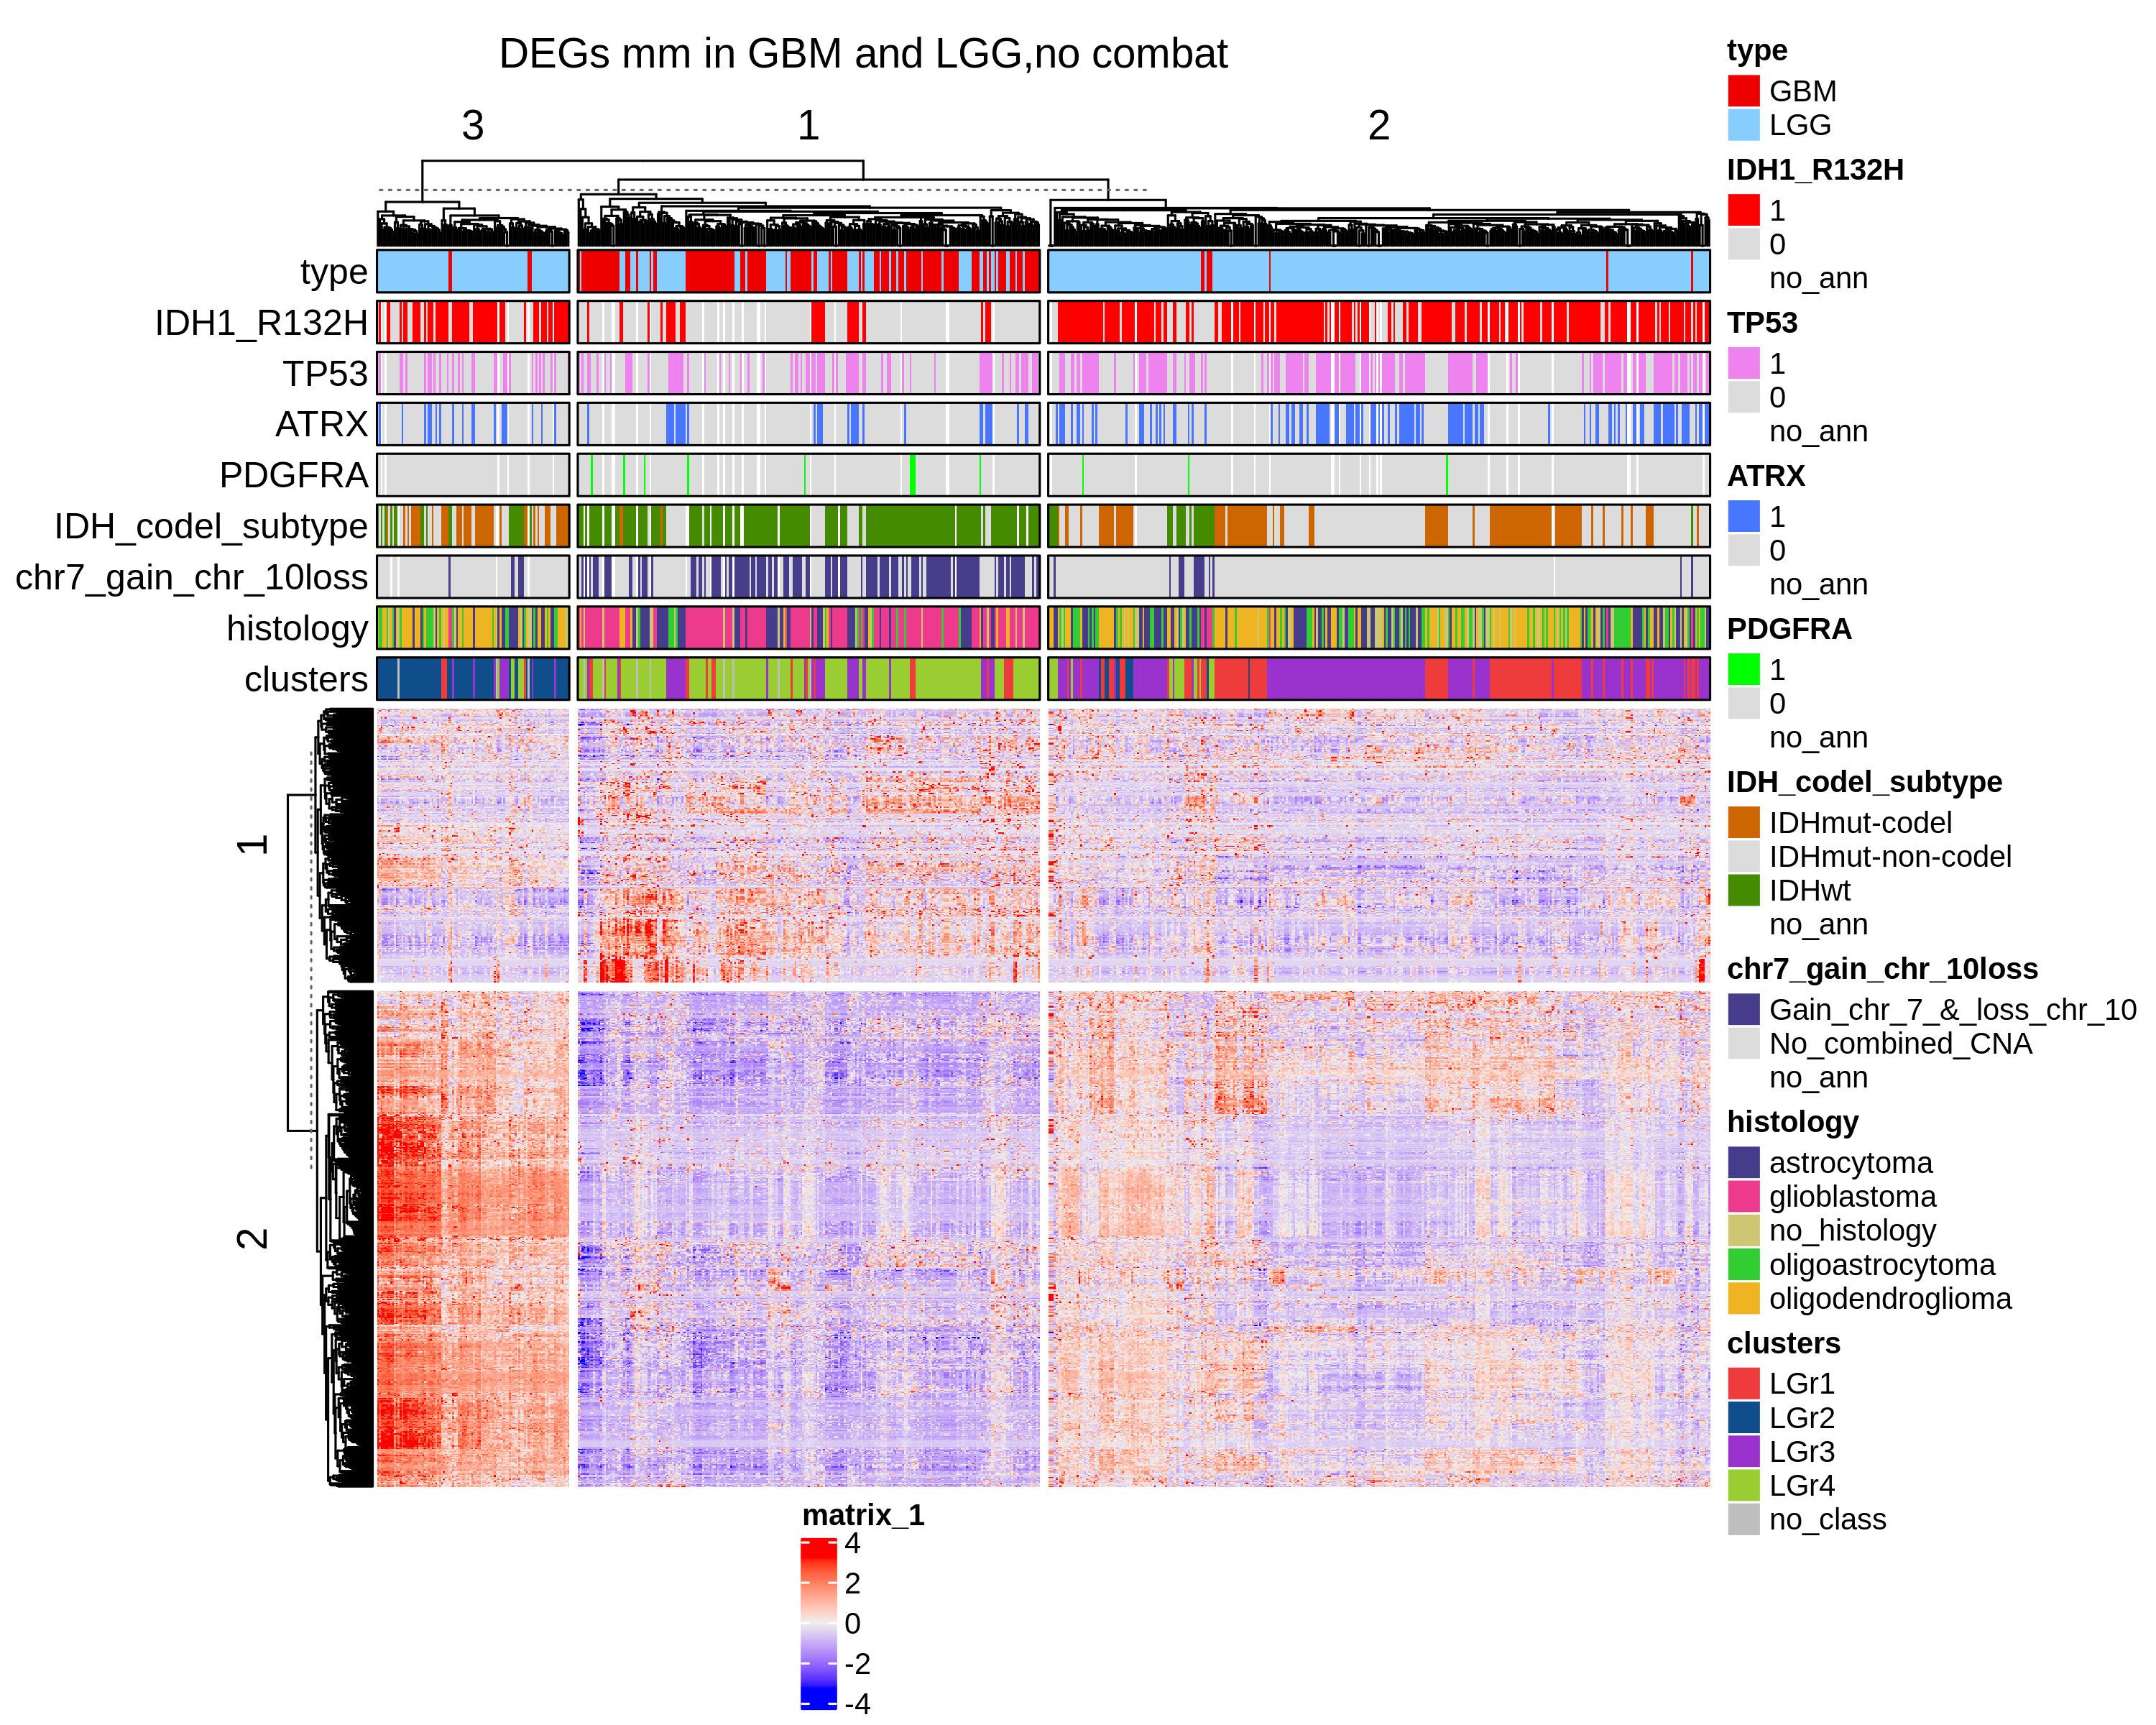
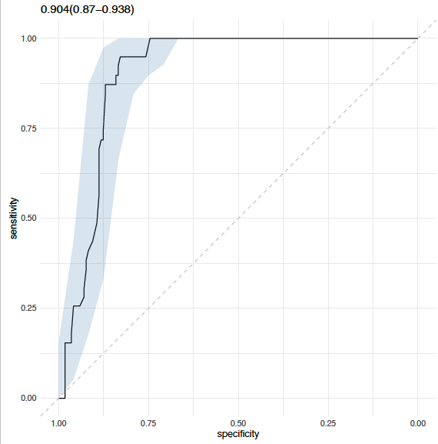
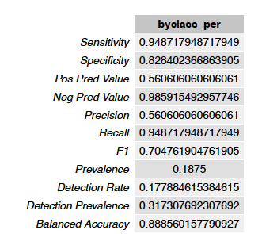
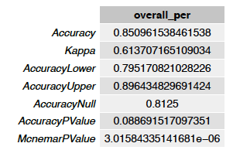
Differentially express genes between C1 vs C2 (q.value 0.01 – 2)
GBM + LGG
(IDH1 + ATRX + TP53 vs REST)
GBM + LGG
n.genes= 797

Slide 7
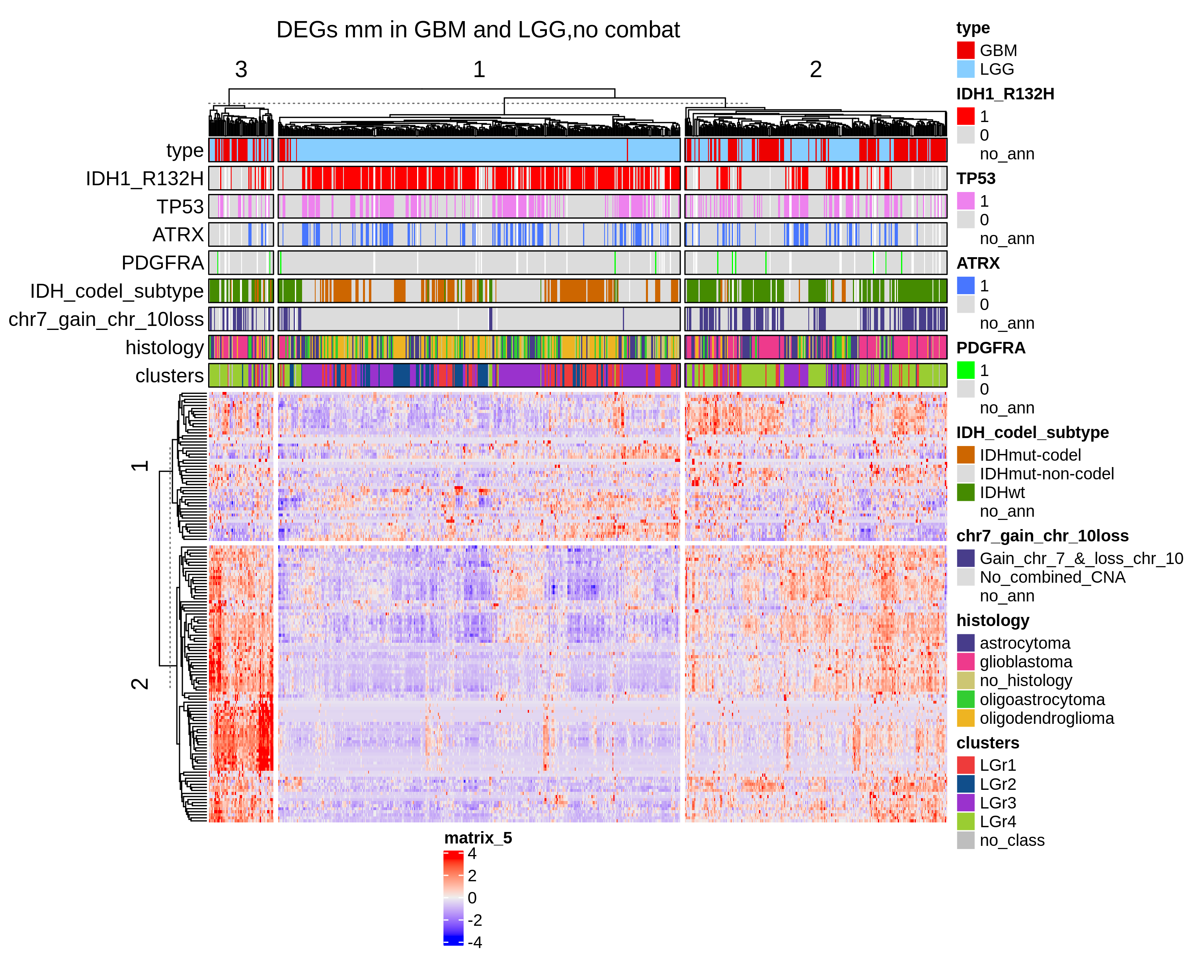
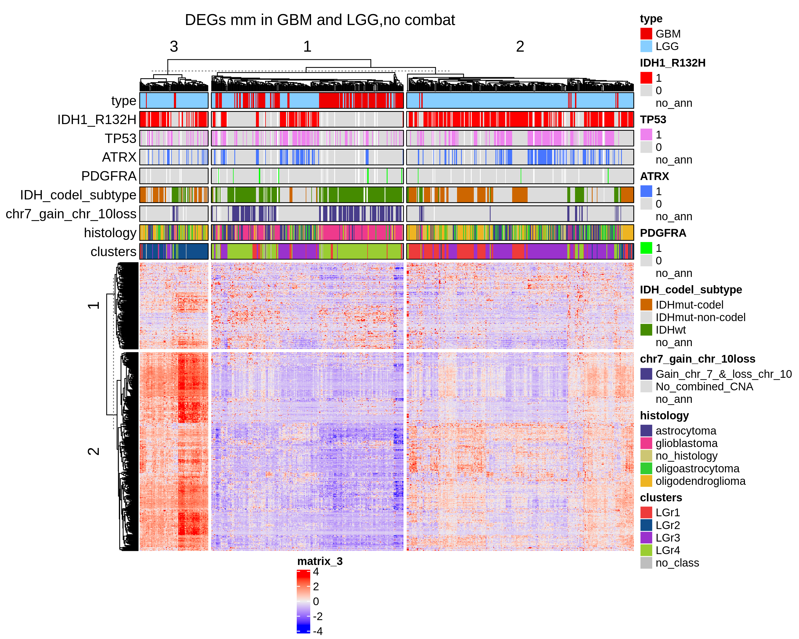
Differentially express genes between C1 vs C2 (q.value 0.01 – 2)
GBM + LGG
UP regulated genes
Down regulated genes

Slide 8
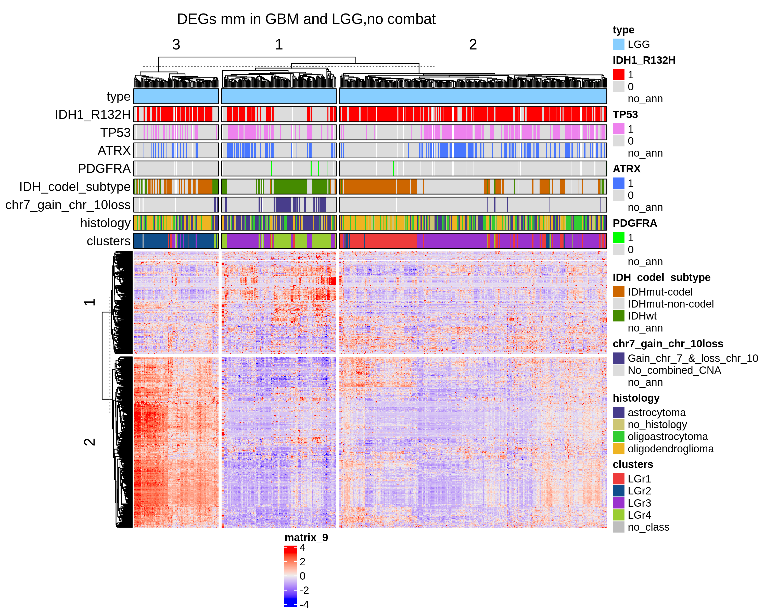
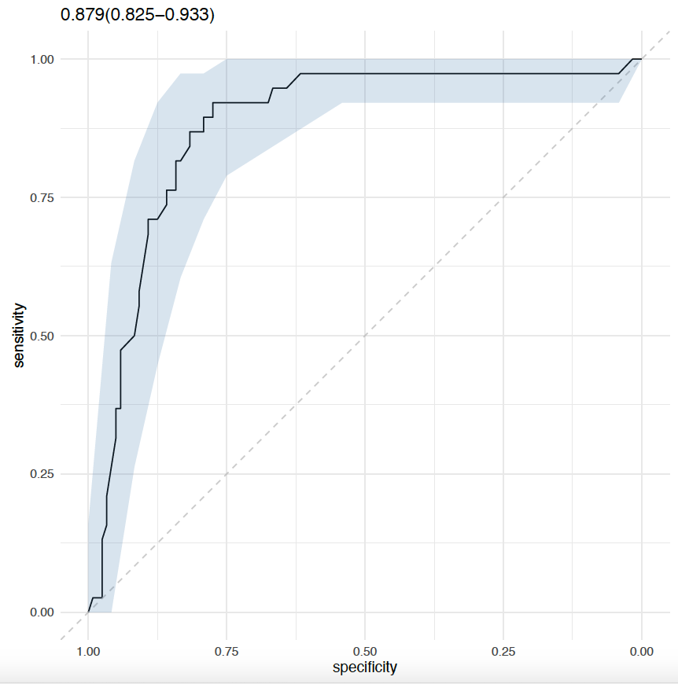
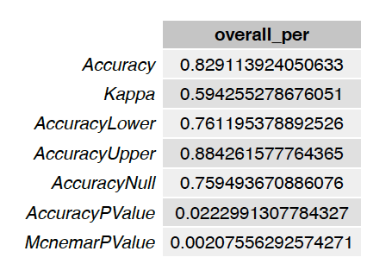
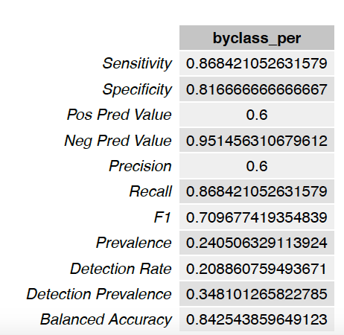
Differentially express genes between C1 vs C2 (q.value 0.01 – 2)
LGG
Show only the samples with TRIPLE mutations

Slide 9
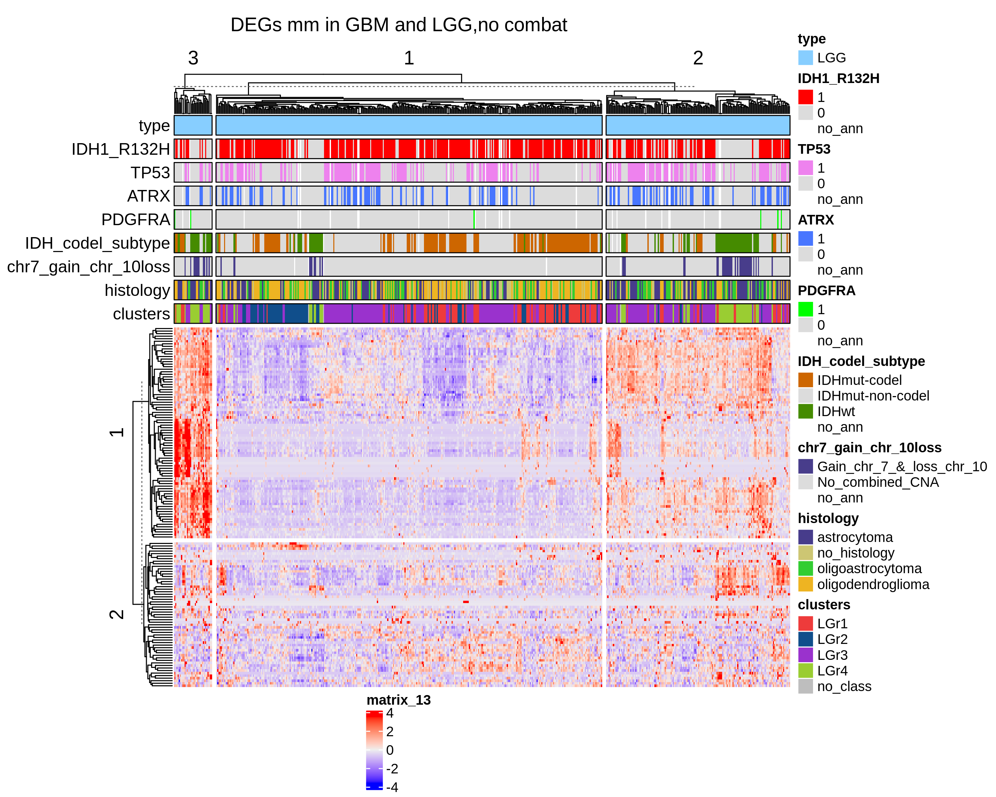
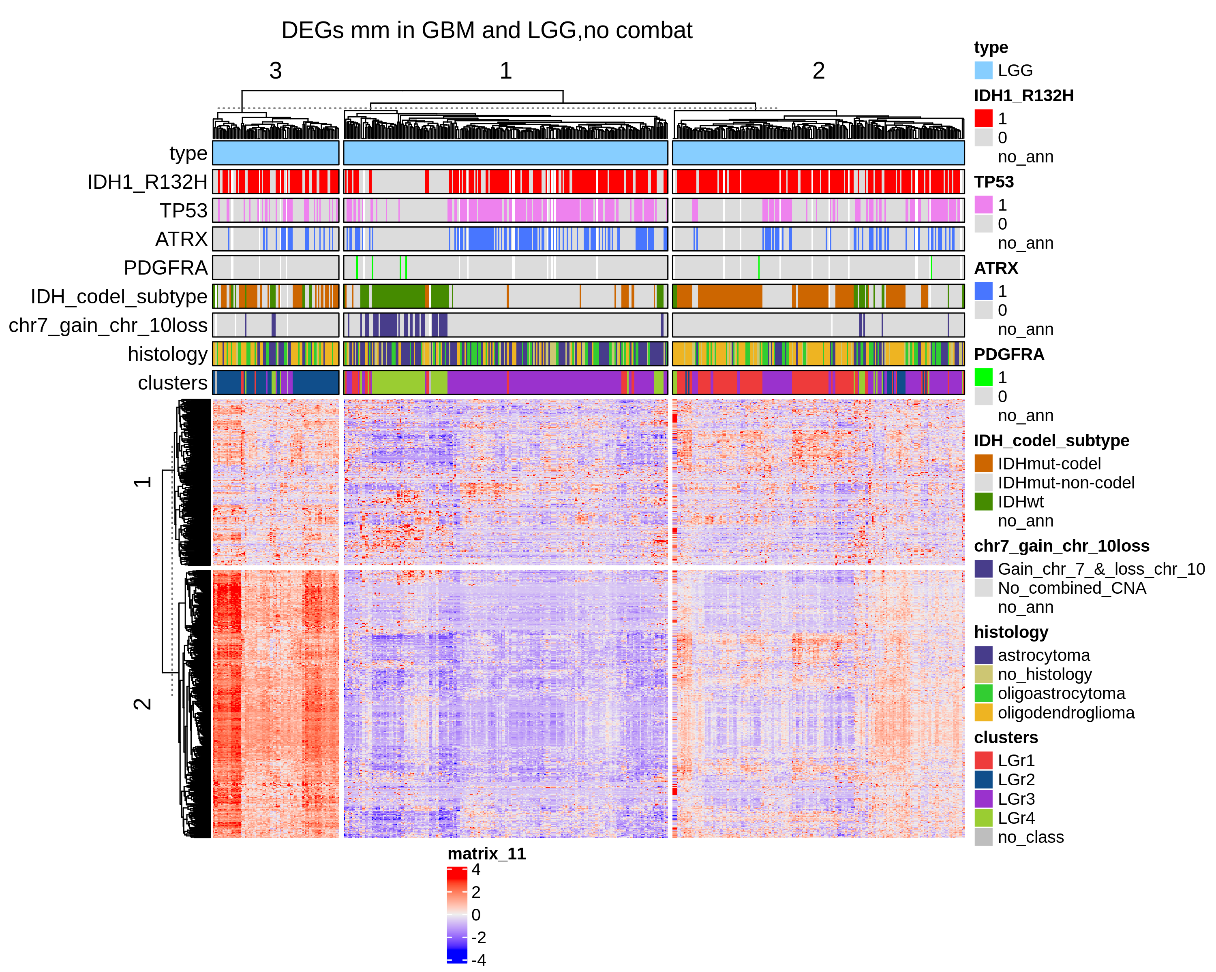
Differentially express genes between C1 vs C2 (q.value 0.01 – 2)
LGG
UP regulated genes
DOWN regulated genes

Slide 10
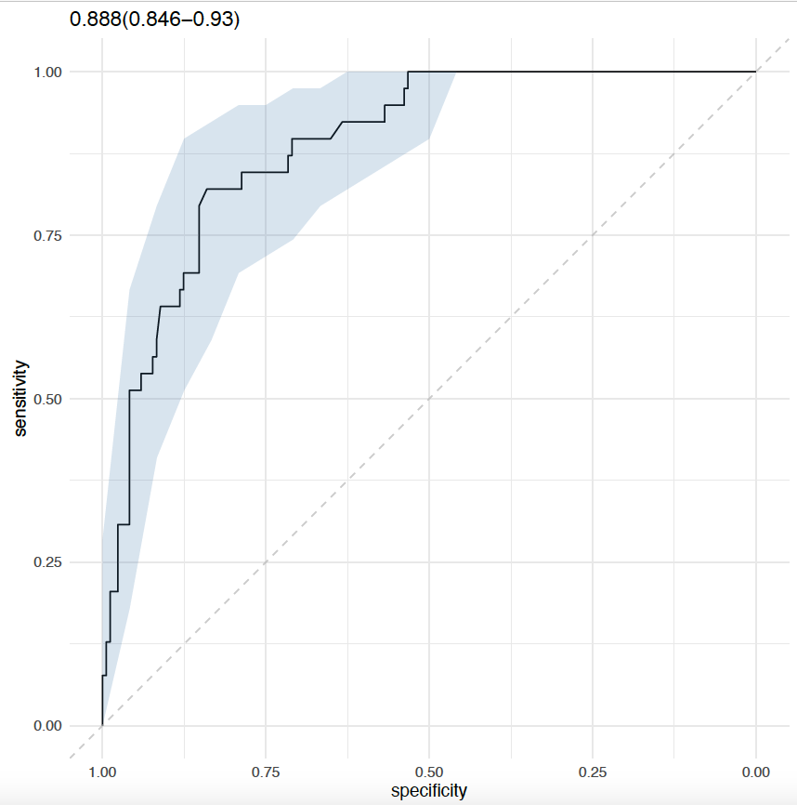
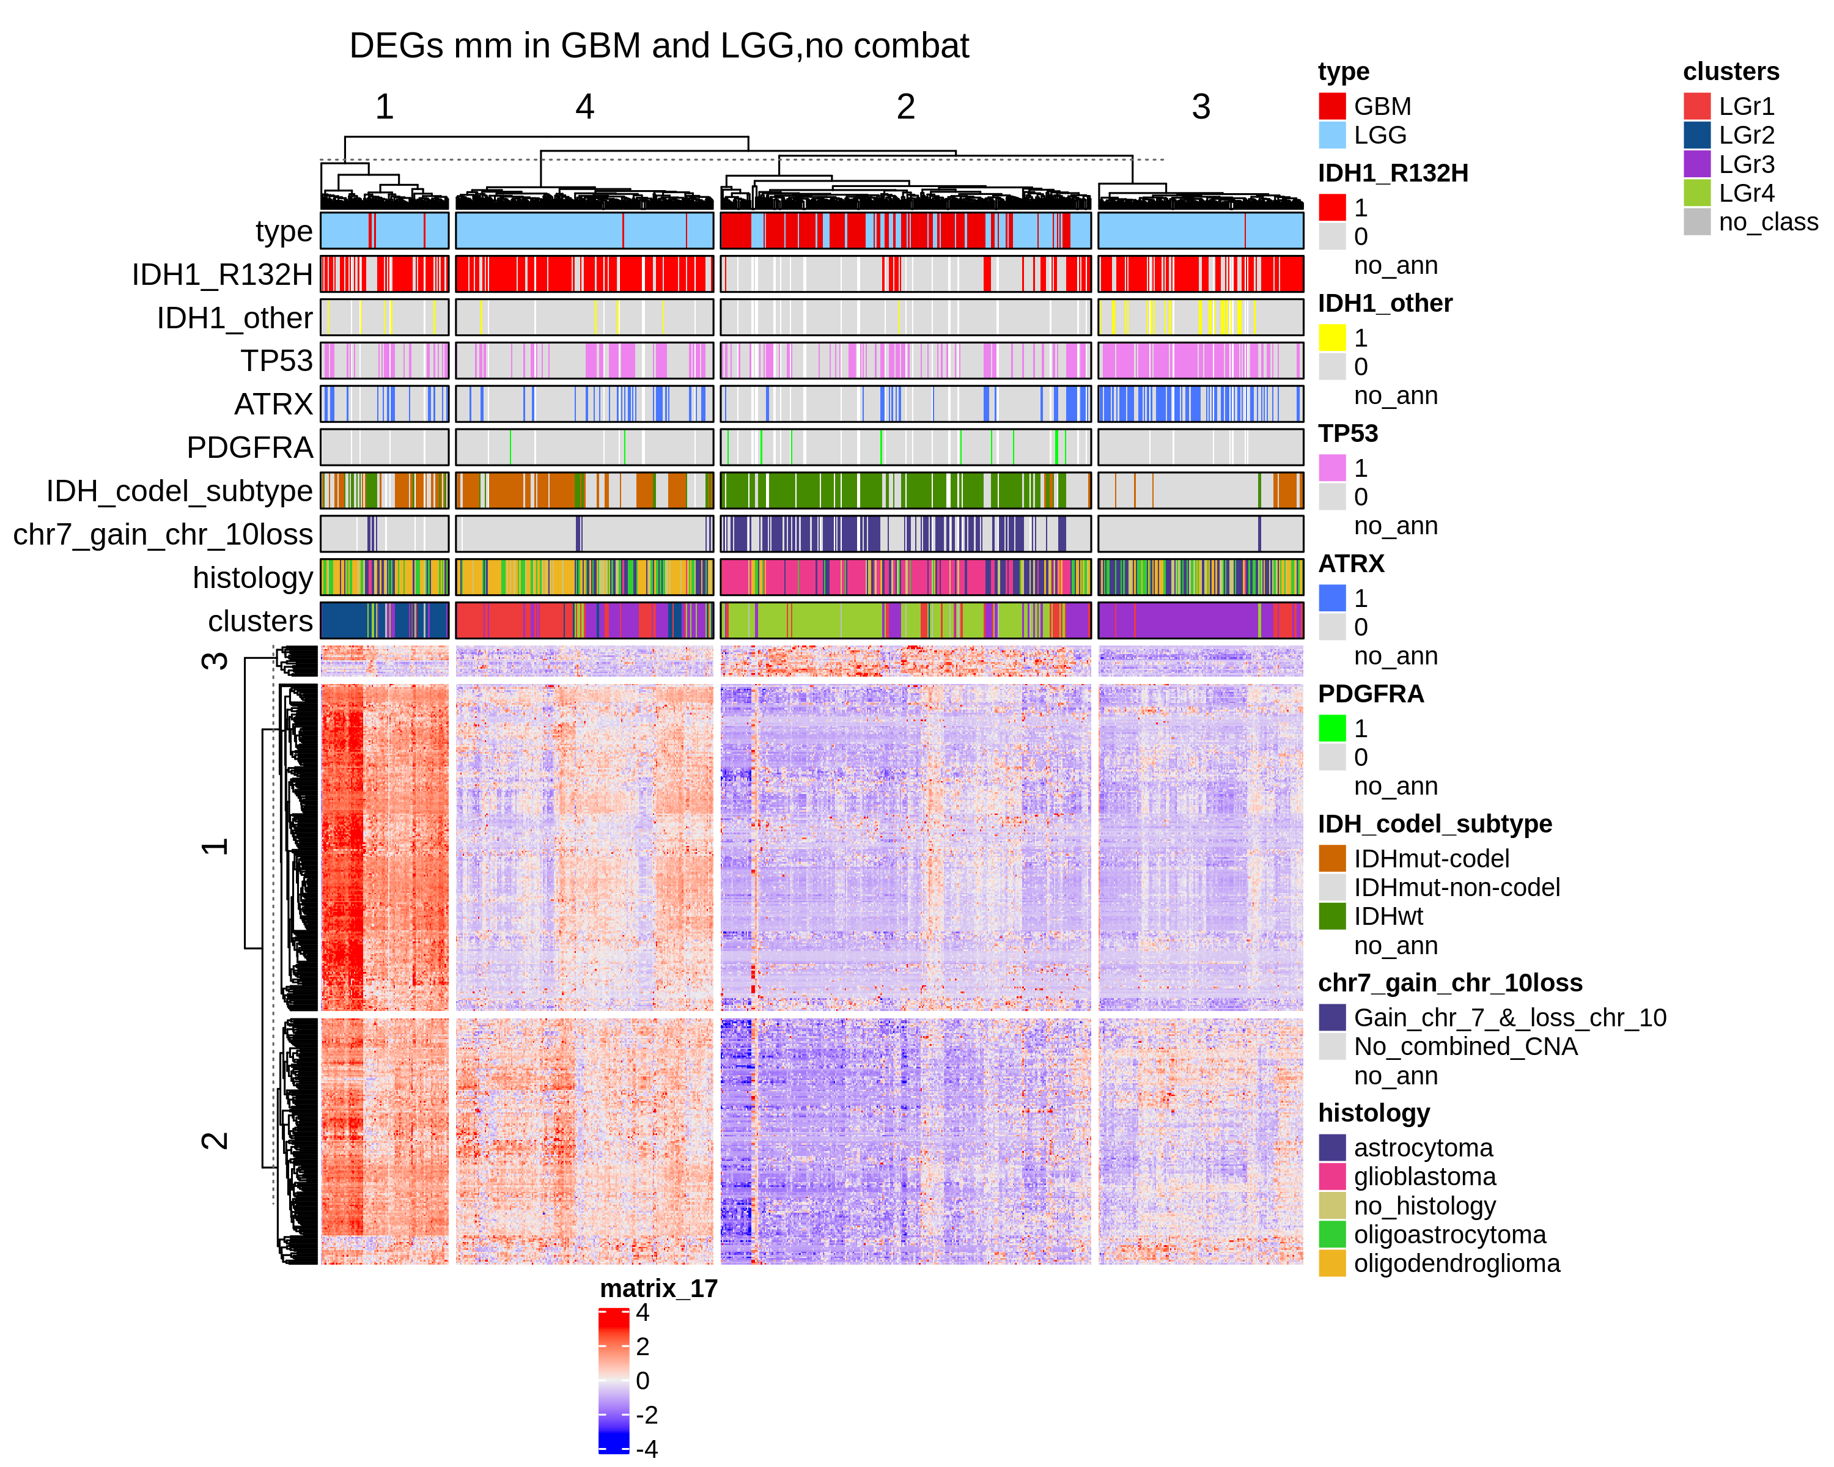
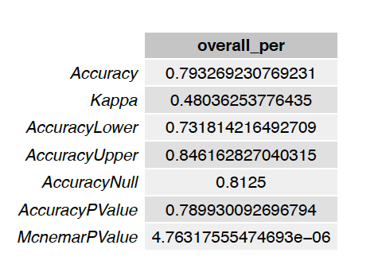
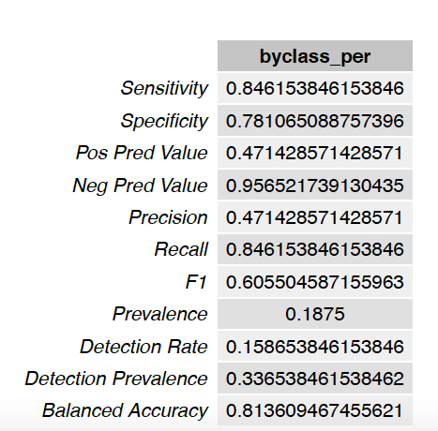
Differentially express genes between C1 vs C2 (q.value 0.01 – 2) + 2 filtering
GBM + LGG
GBM + LGG
(IDH1 + ATRX + TP53 vs REST)
N.Genes = 373

Slide 11
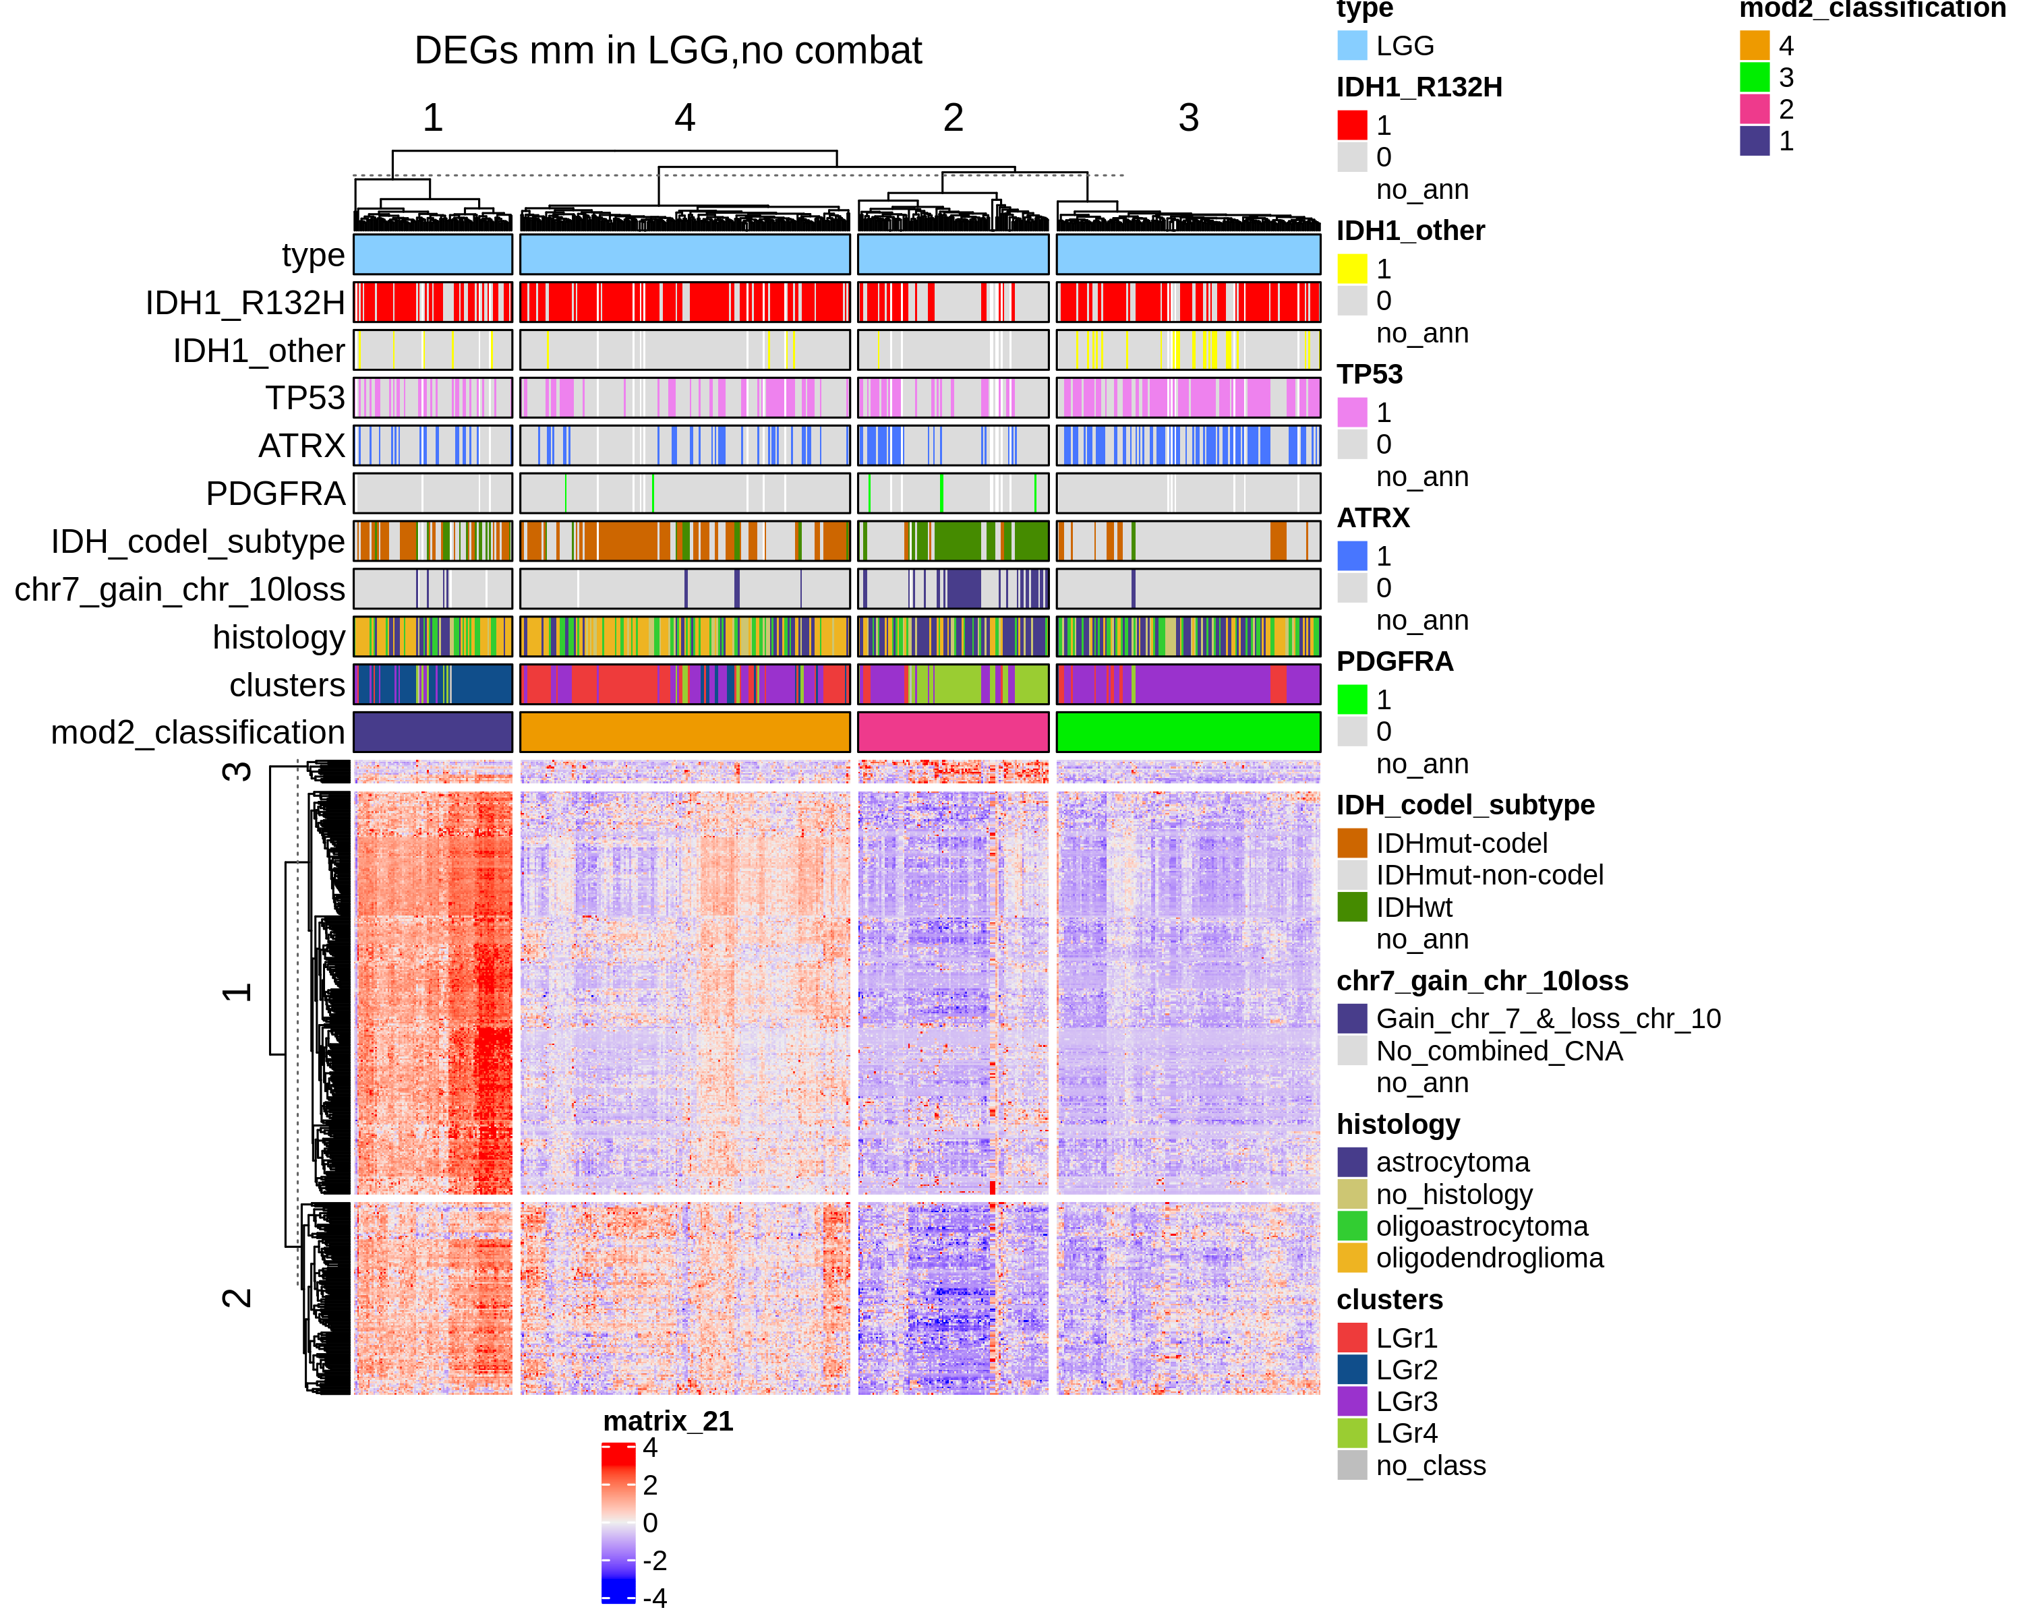
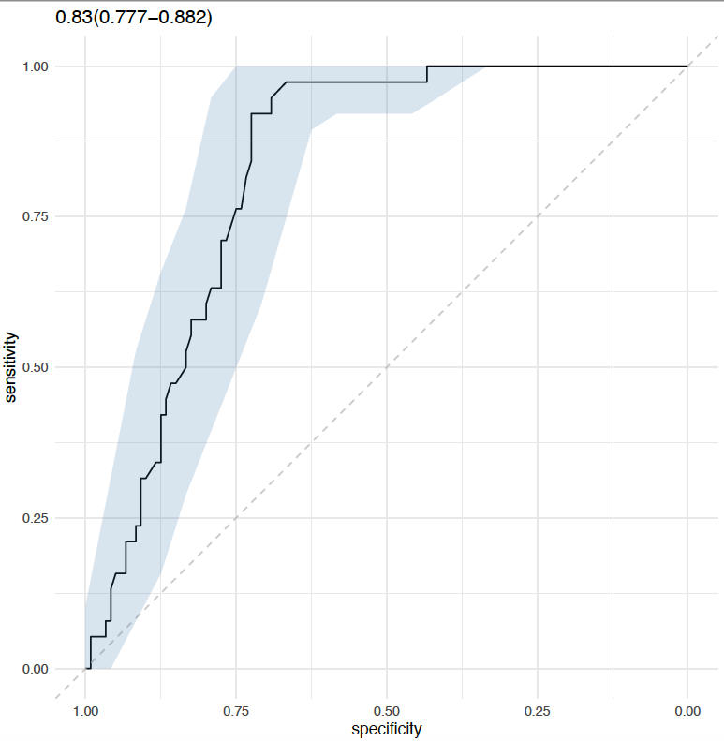
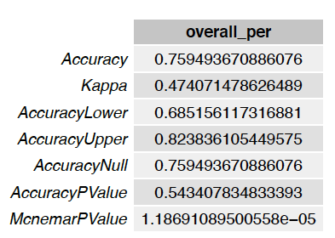
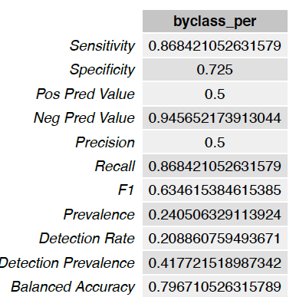
Differentially express genes between C1 vs C2 (q.value 0.01 – 2) + 2 filtering
LGG
GBM + LGG
(IDH1 + ATRX + TP53 vs REST)

Slide 12
C1A vs C1B

Slide 13
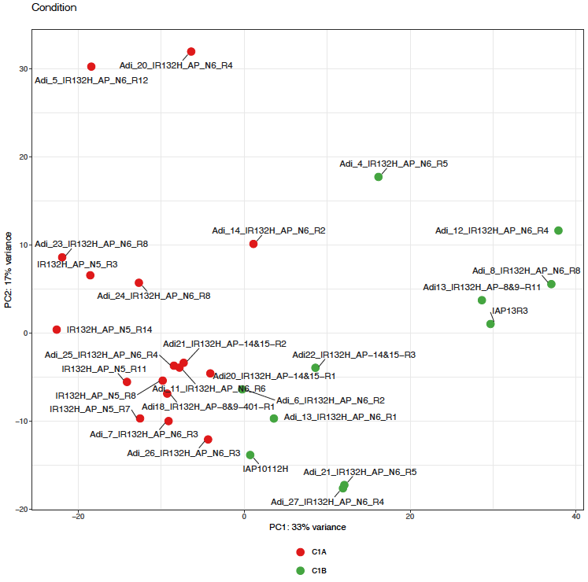
- Adi_9_IR132H_AP_N6_R3

Slide 14
Number of genes DEGs between C1A and C1B
Analysis November 11/11/2020
qval lfc | 0.05 1 | 0.05 2 | 0.05 3 | 0.01 1 | 0.01 2 | 0.01 3 | 0.001 1 | 0.001 2 | 0.001 3 | 1e-04 1 | 1e-04 2 | 1e-04 3
DESeq2_rmv5_Adi18_10_22_CSHS15 | 2215 | 838 | 146 | 1771 | 704 | 112 | 1345 | 585 | 82 | 1049 | 490 | 55
Analysis February 02/04/2021
qval lfc | 0.05 1 | 0.05 2 | 0.05 3 | 0.01 1 | 0.01 2 | 0.01 3 | 0.001 1 | 0.001 2 | 0.001 3 | 1e-04 1 | 1e-04 2 | 1e-04 3
adi_february_2021 | 1854 | 384 | 3 | 1662 | 384 | 3 | 1261 | 382 | 3 | 920 | 329 | 3
q.value 0.05 and lfc 1
q.value 0.05 and lfc 2
(Ceccarelli size = 2274)
(Ceccarelli size = 2274)
7 %
1 %

Slide 15
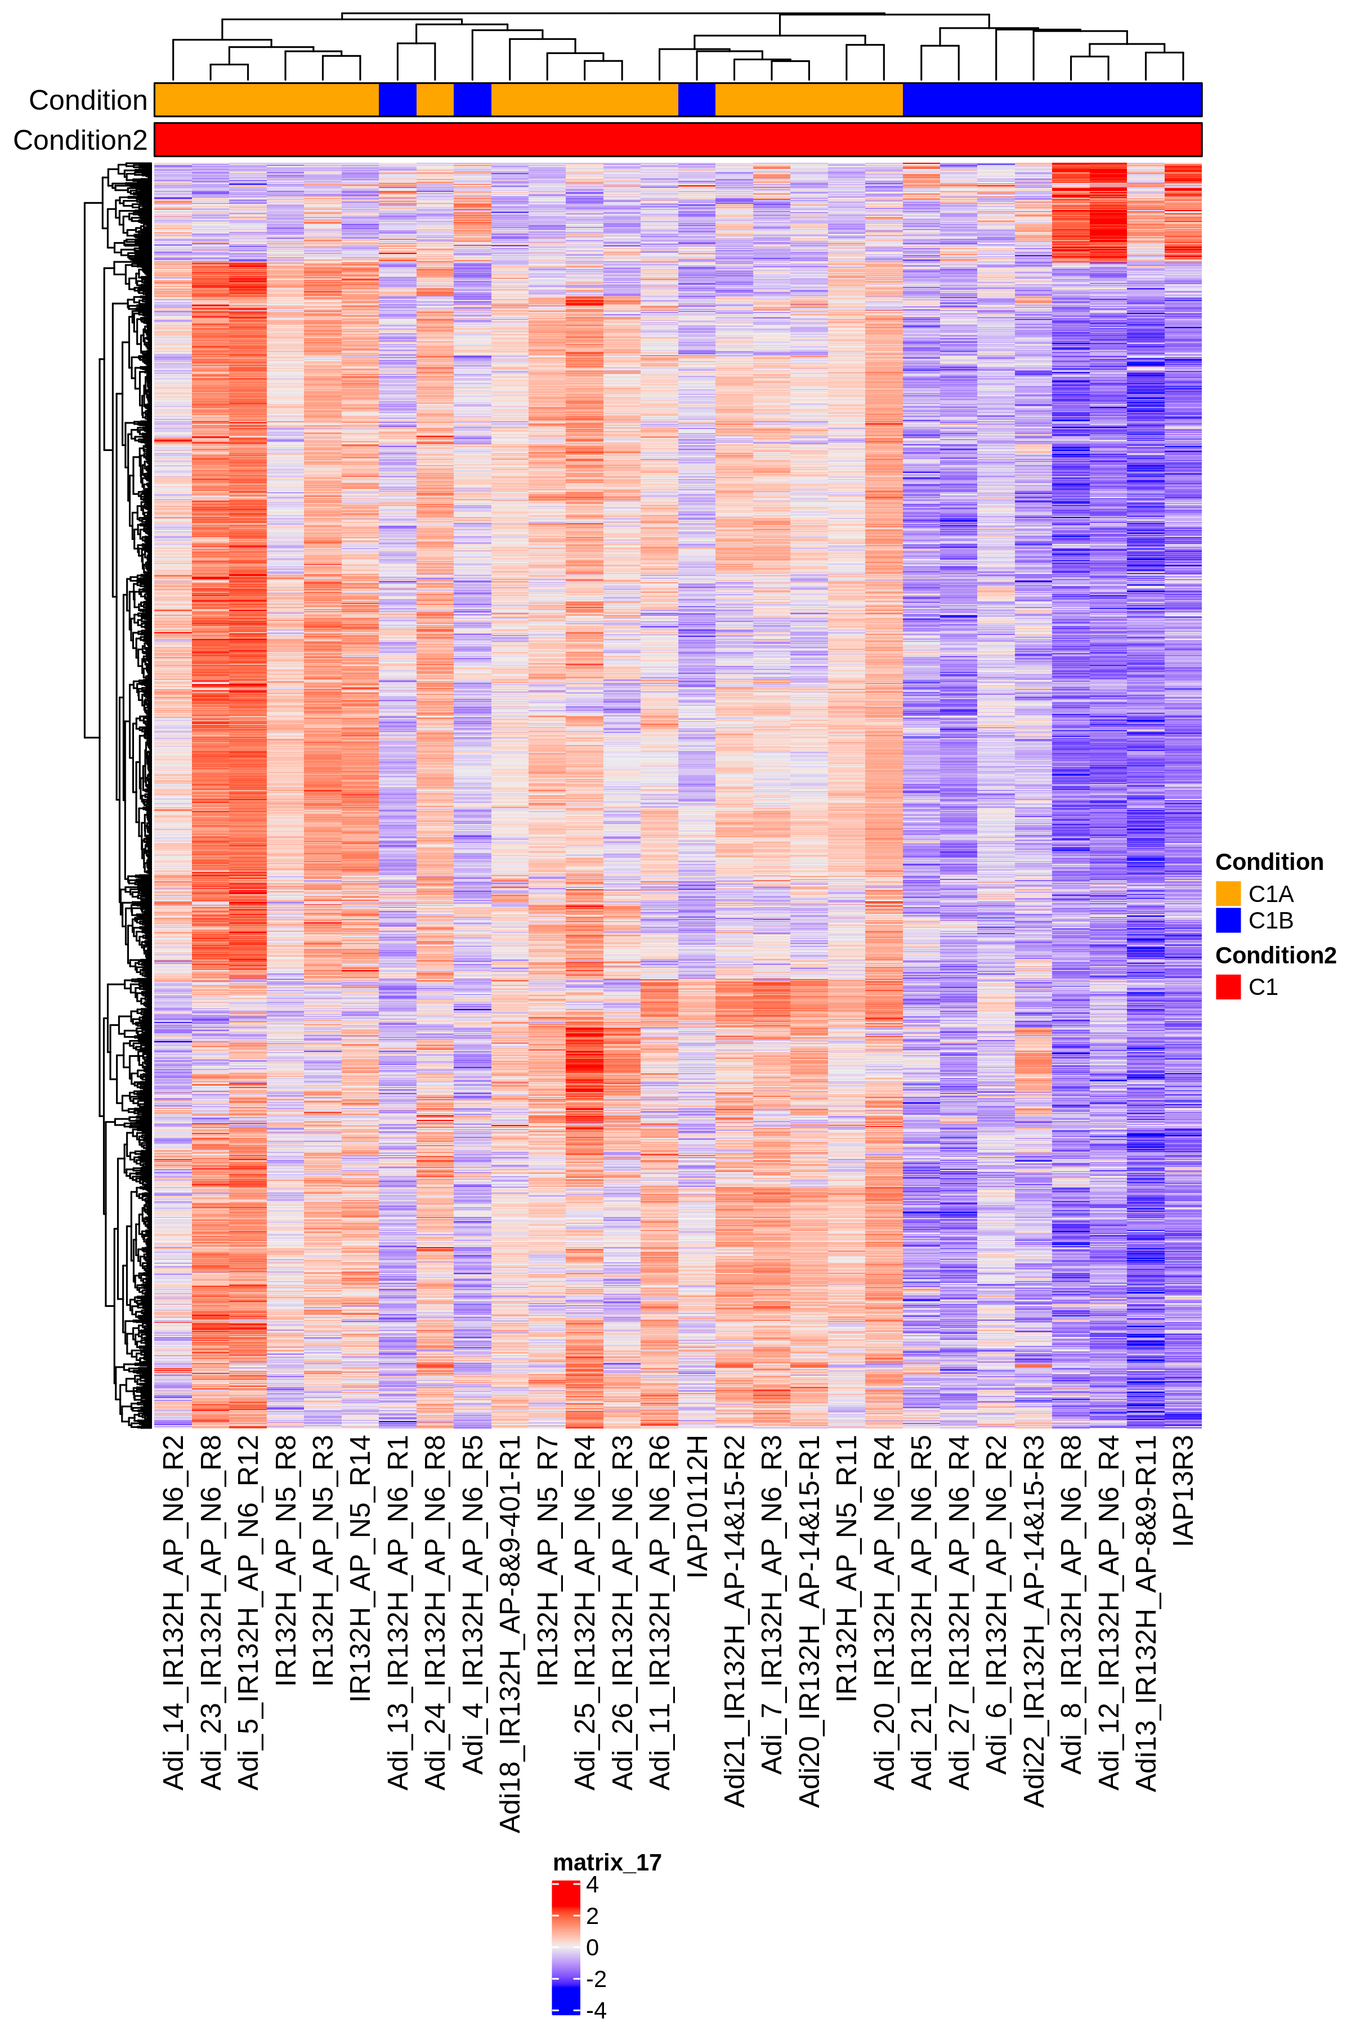
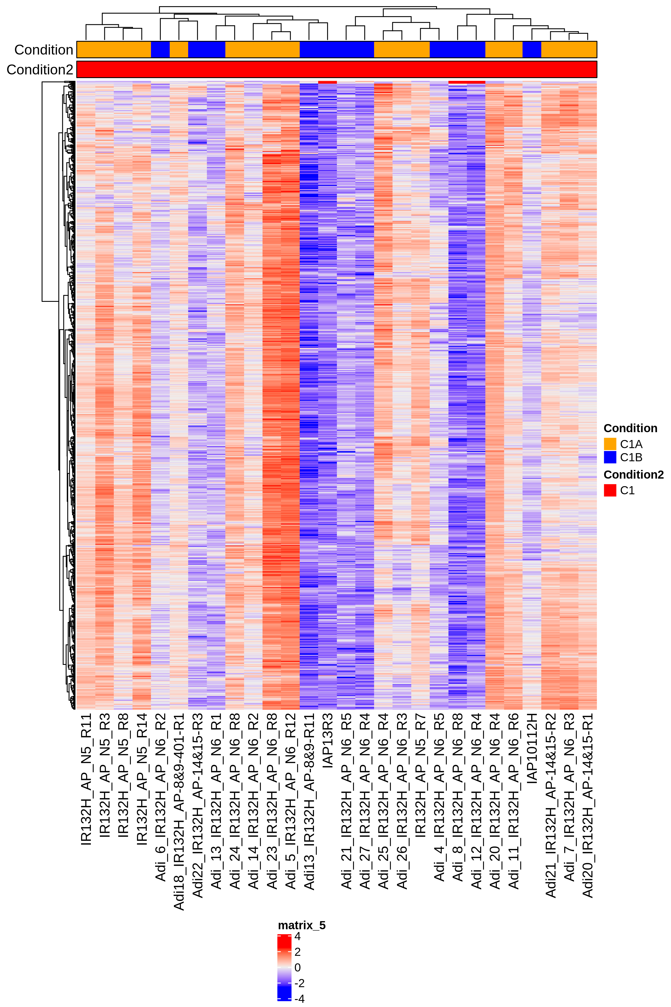
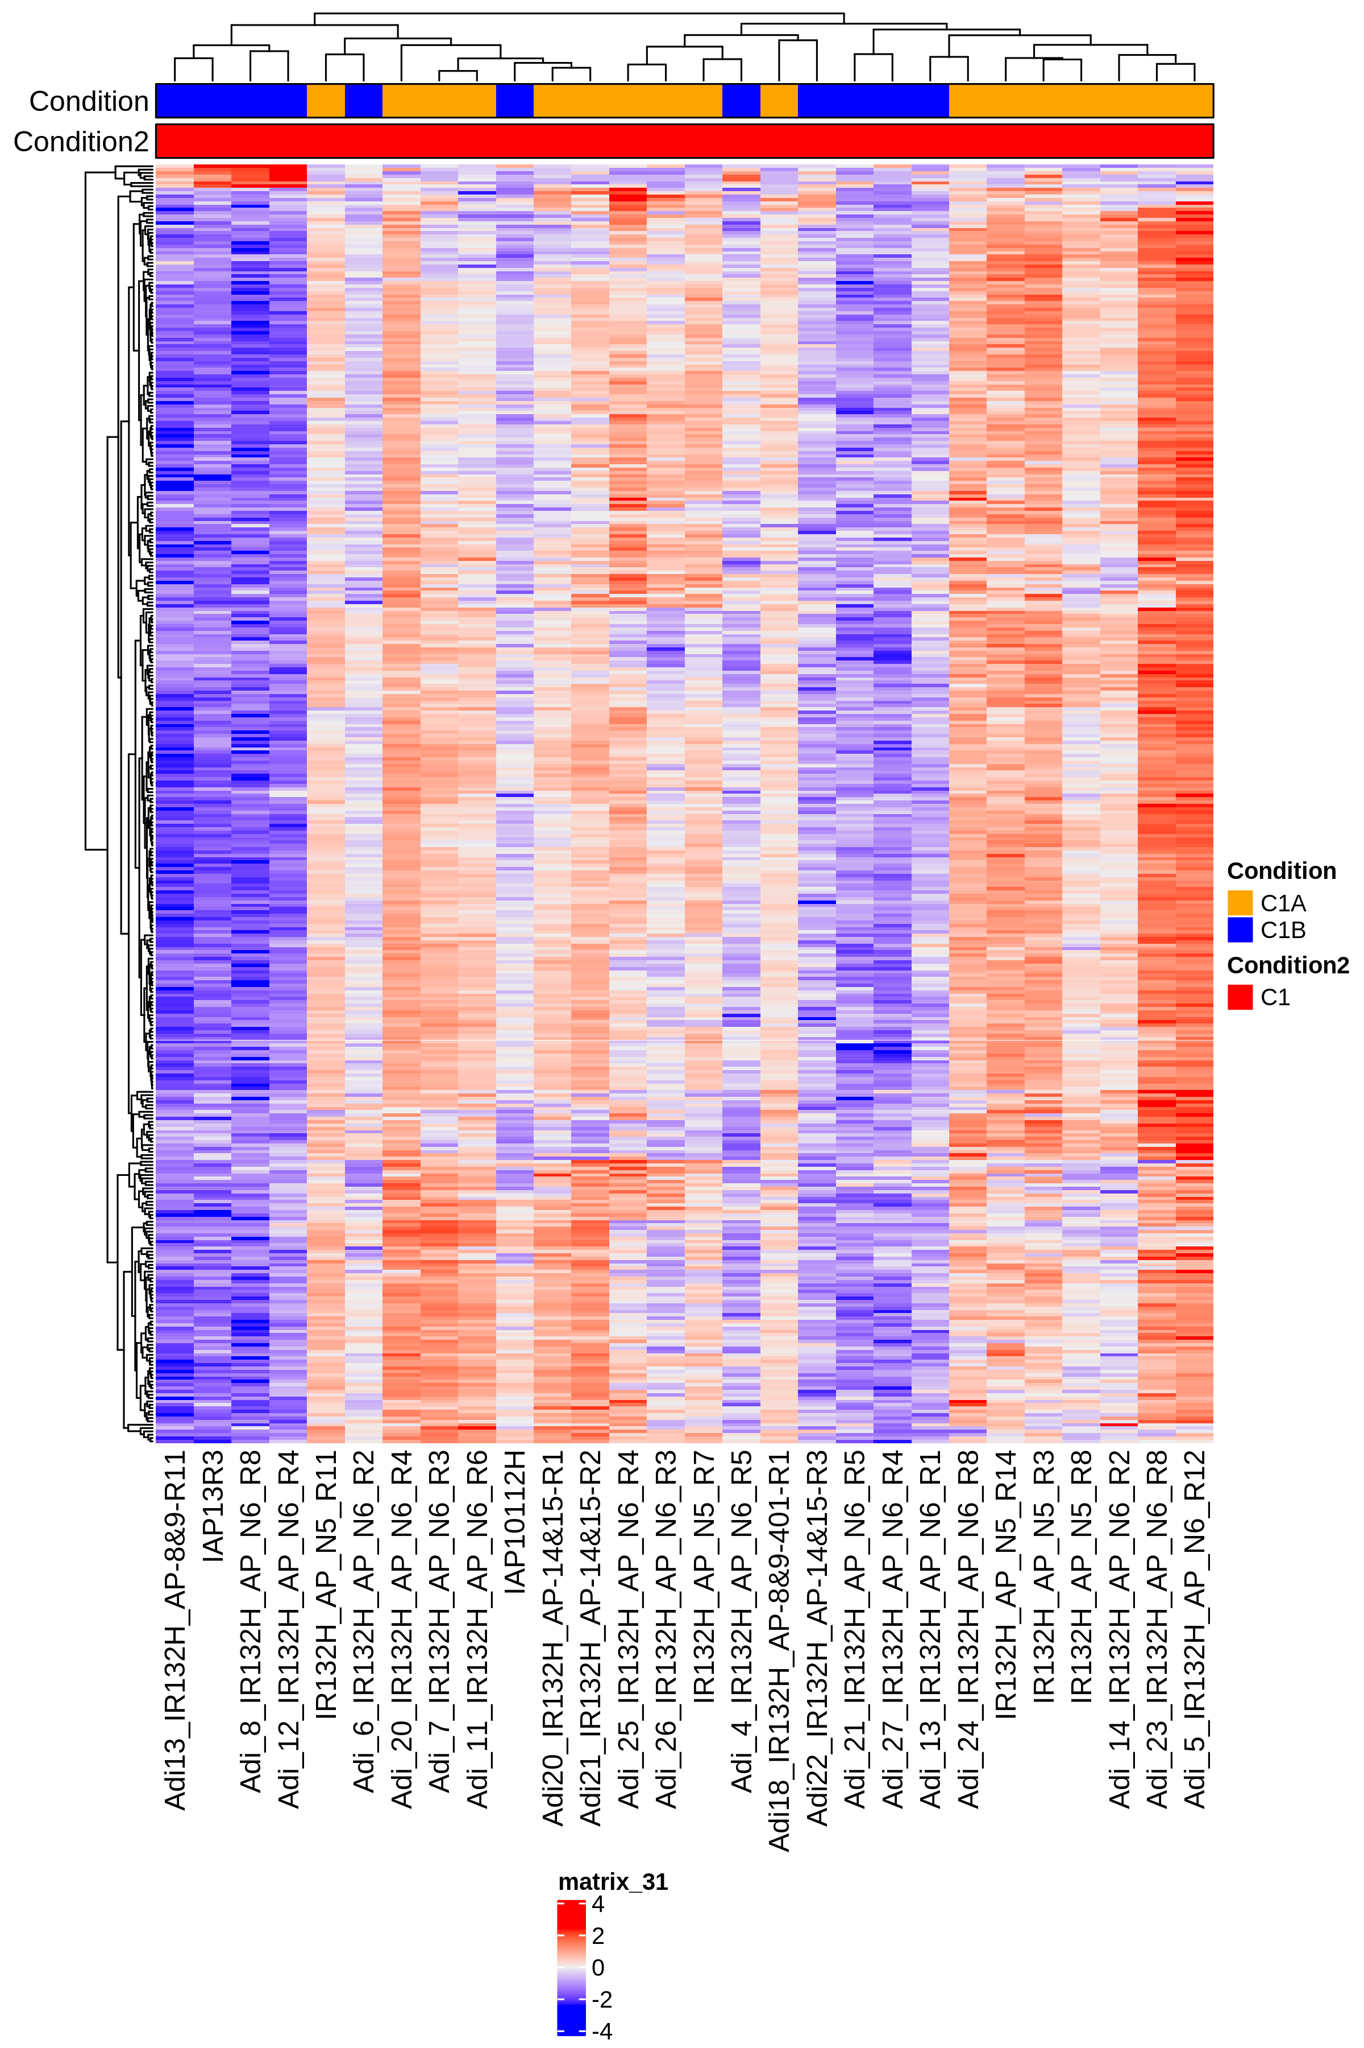
q.value 0.05 and lfc 1
q.value 0.0001 and lfc 1
q.value 0.05 and lfc 2

Slide 16
q.value 0.05 and lfc 1

Slide 17
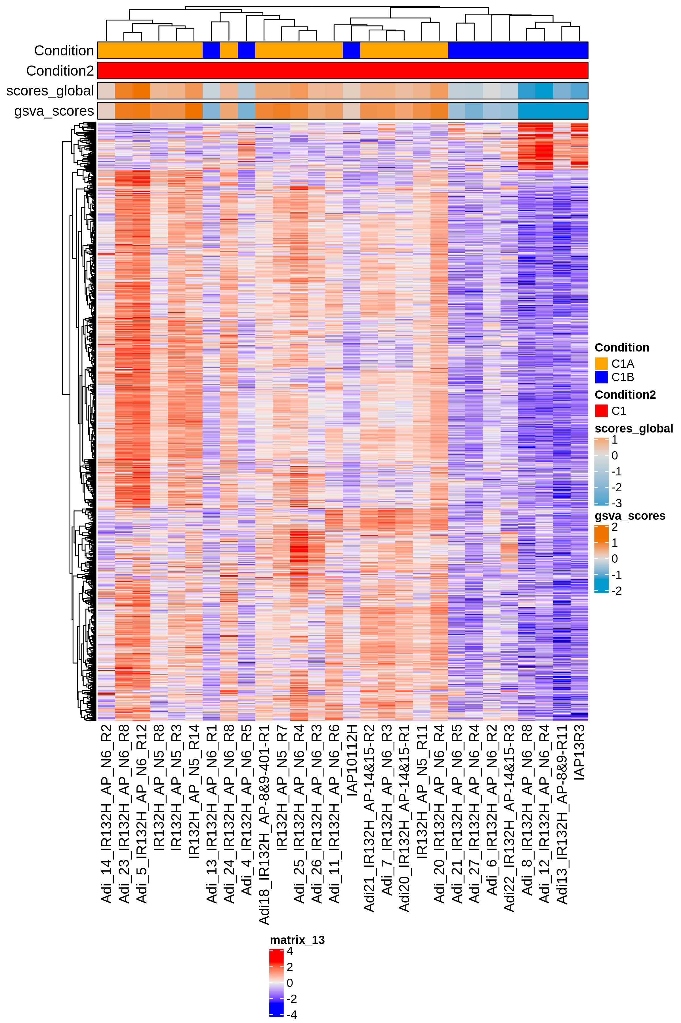
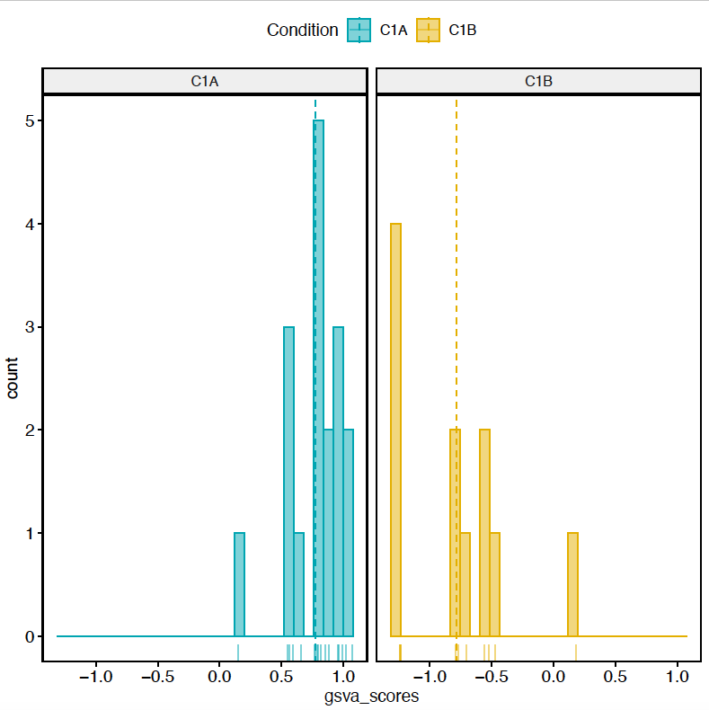
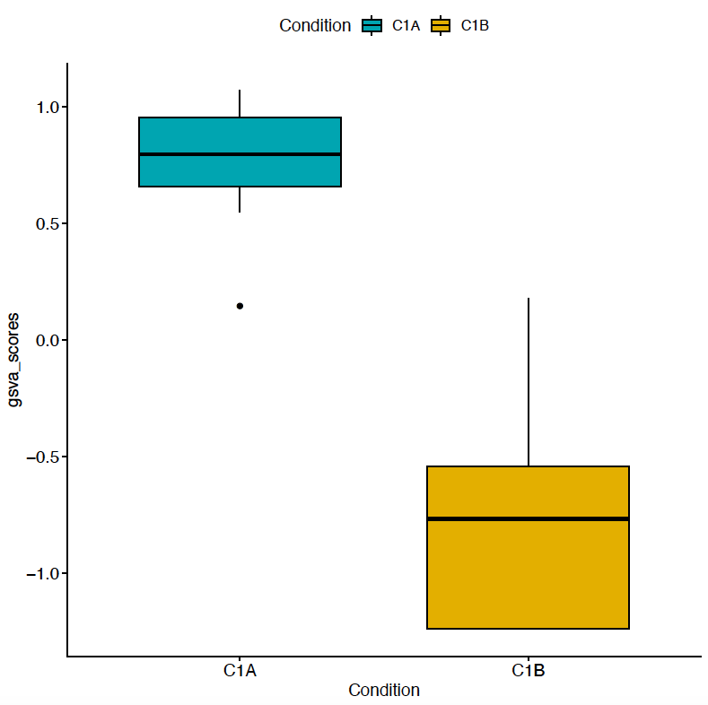
n. genes = 1854

Slide 18
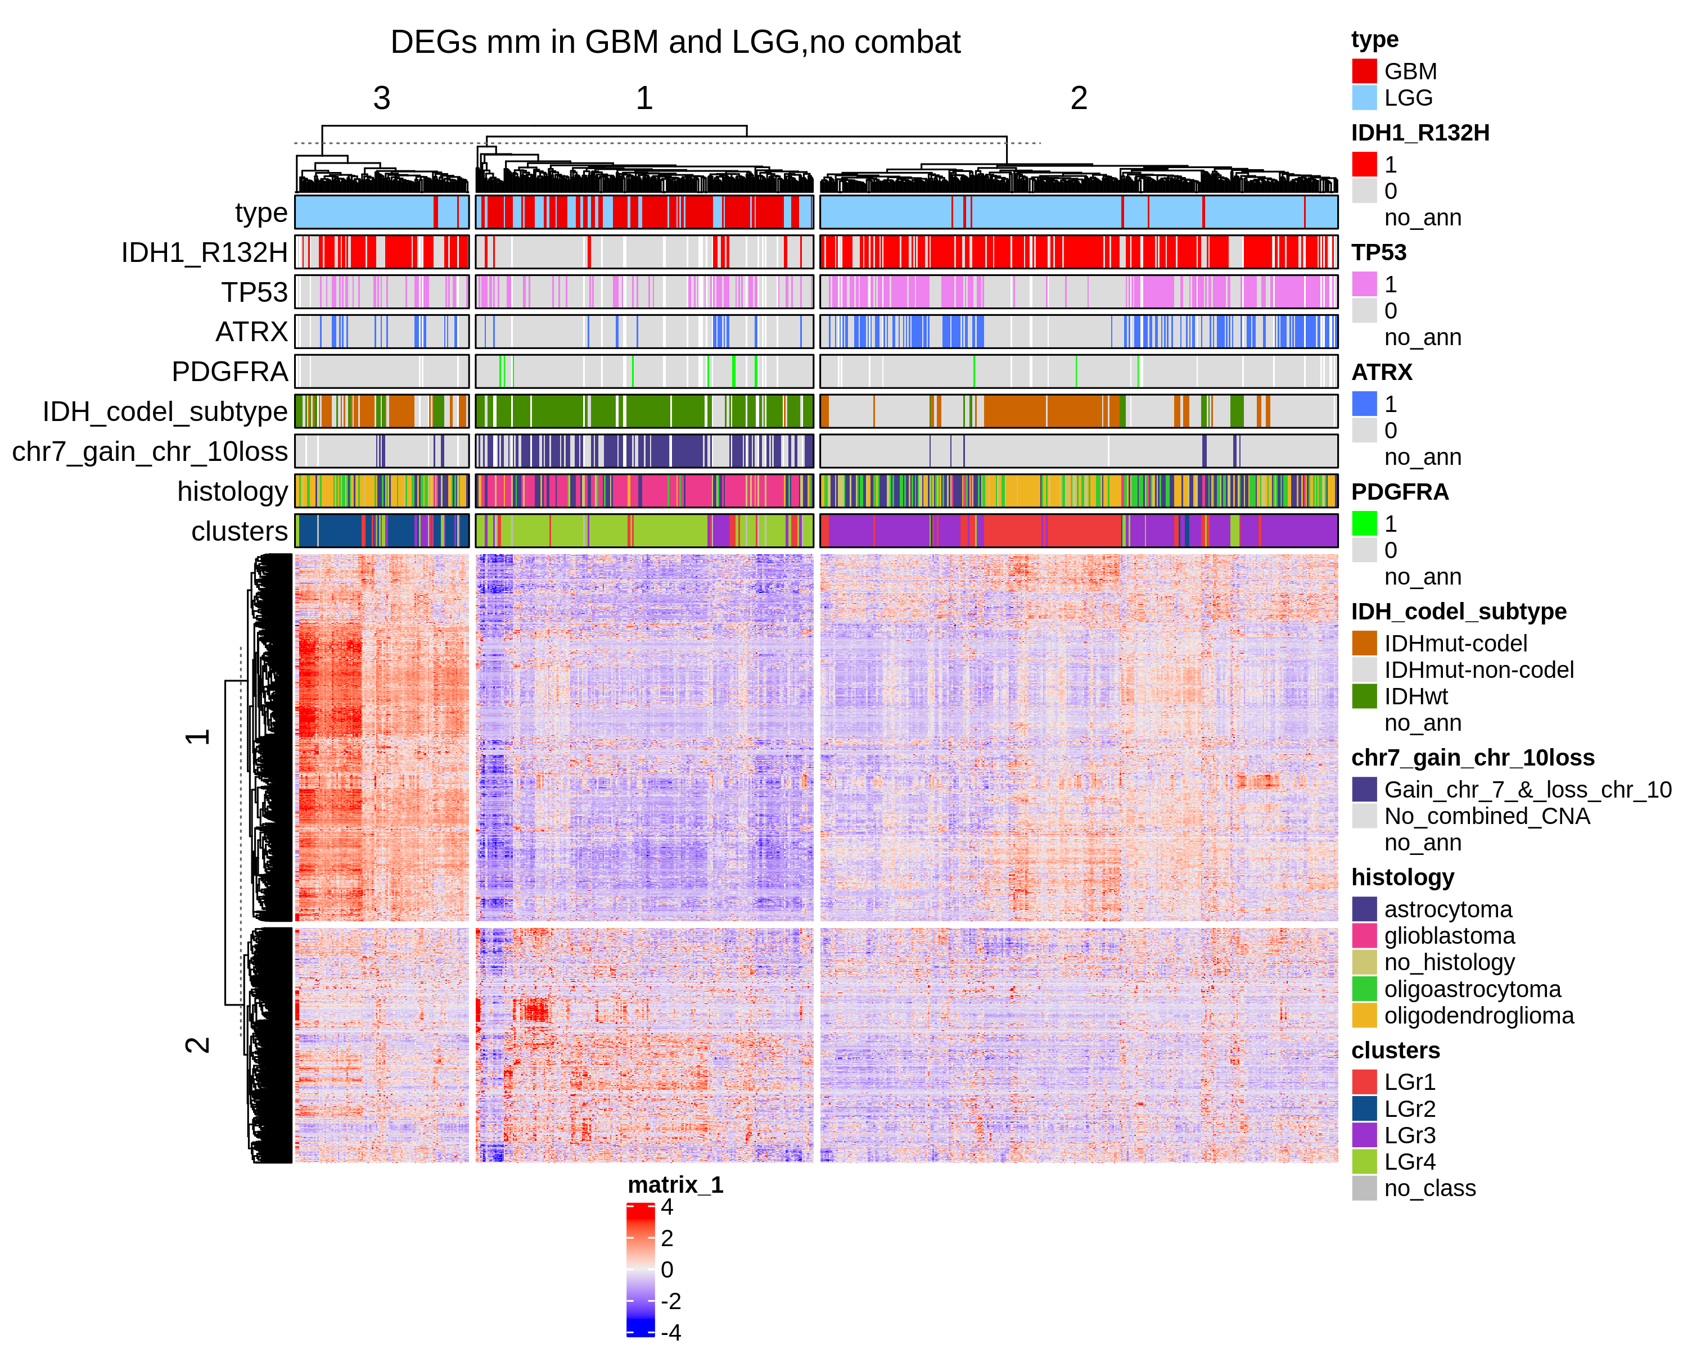
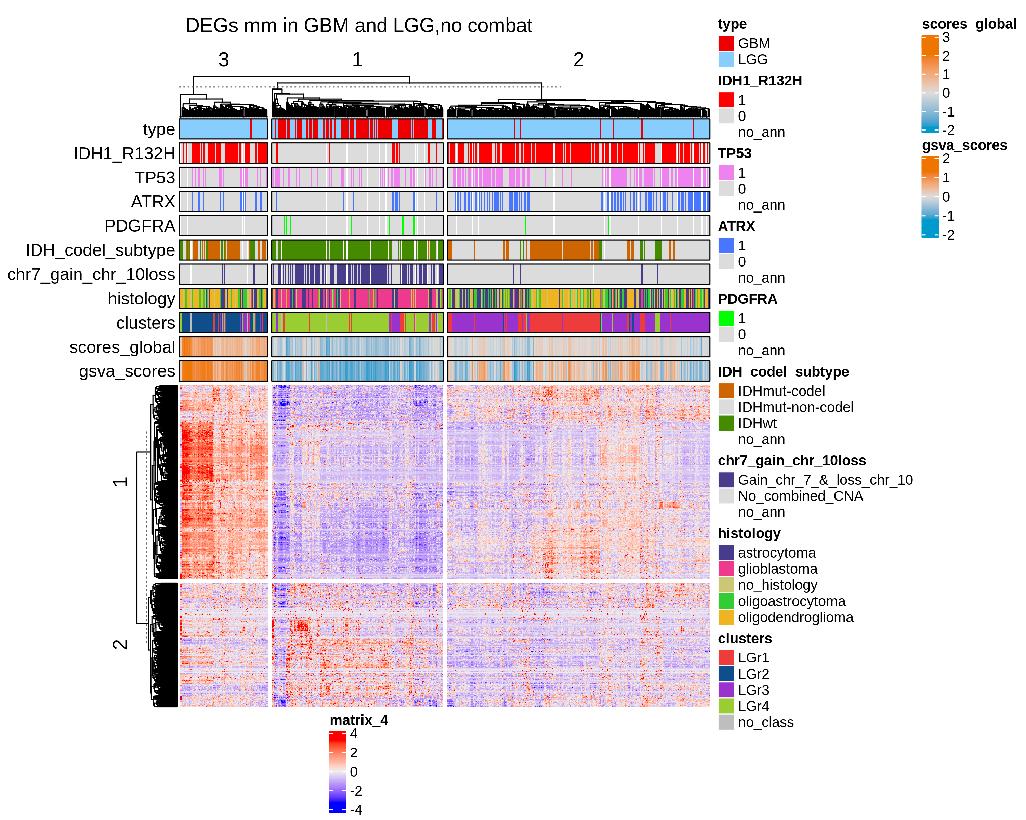
q.value 0.05 and lfc 1
n. genes = 1556

Slide 19
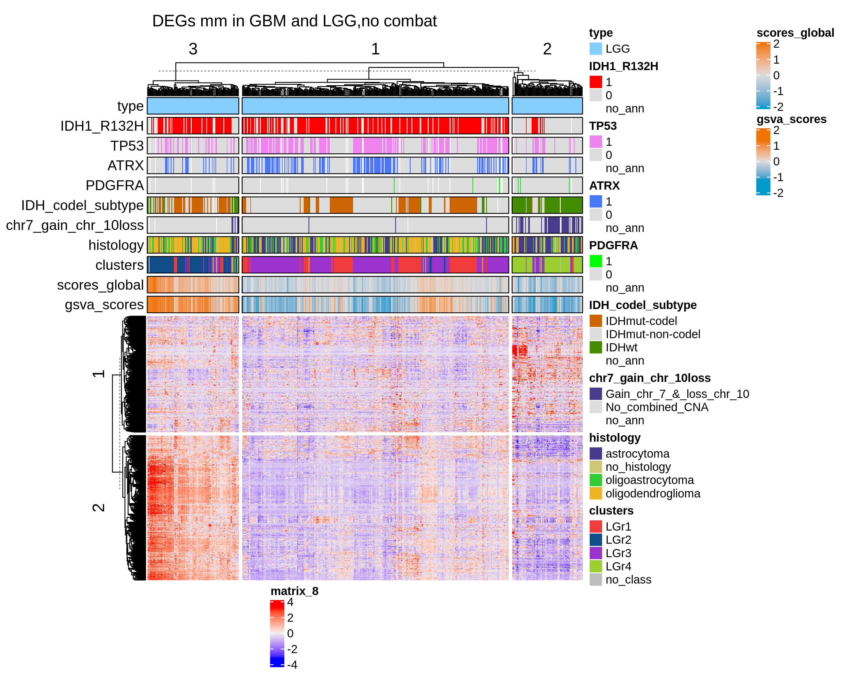
LGG q.value 0.05 and lfc 1

Slide 20
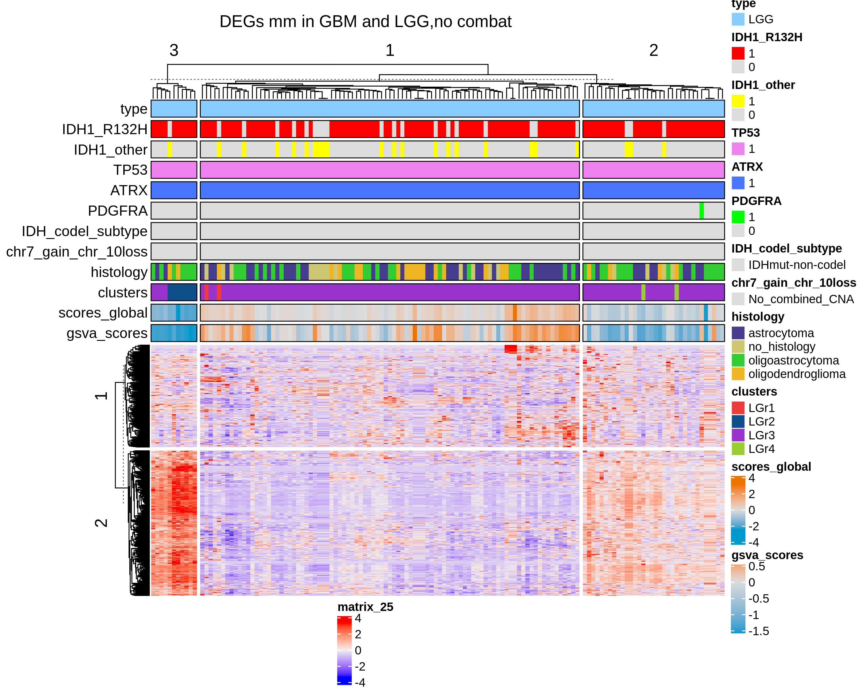
LGG IDH+ ATRX + TP53 q.value 0.05 and lfc 1

Slide 21
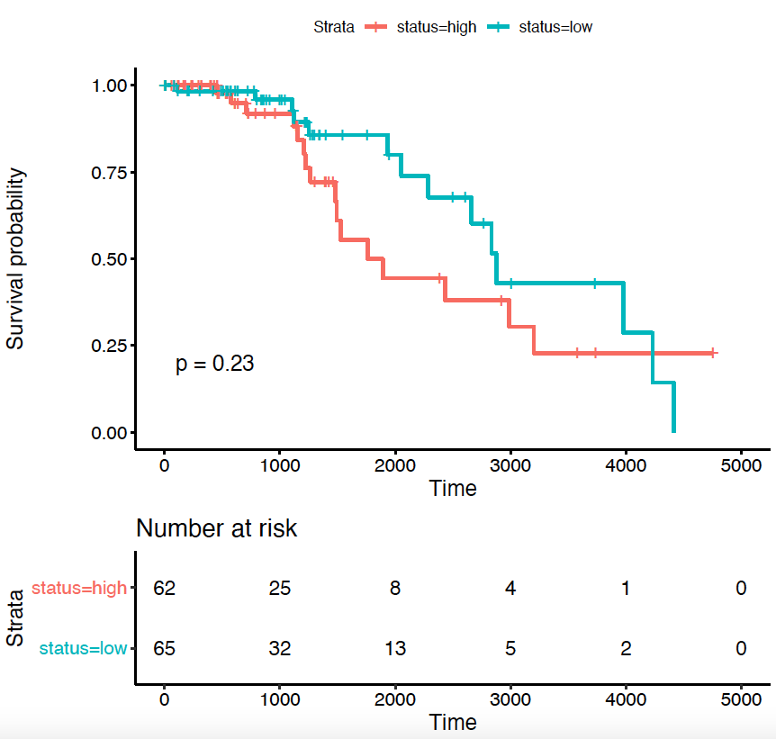
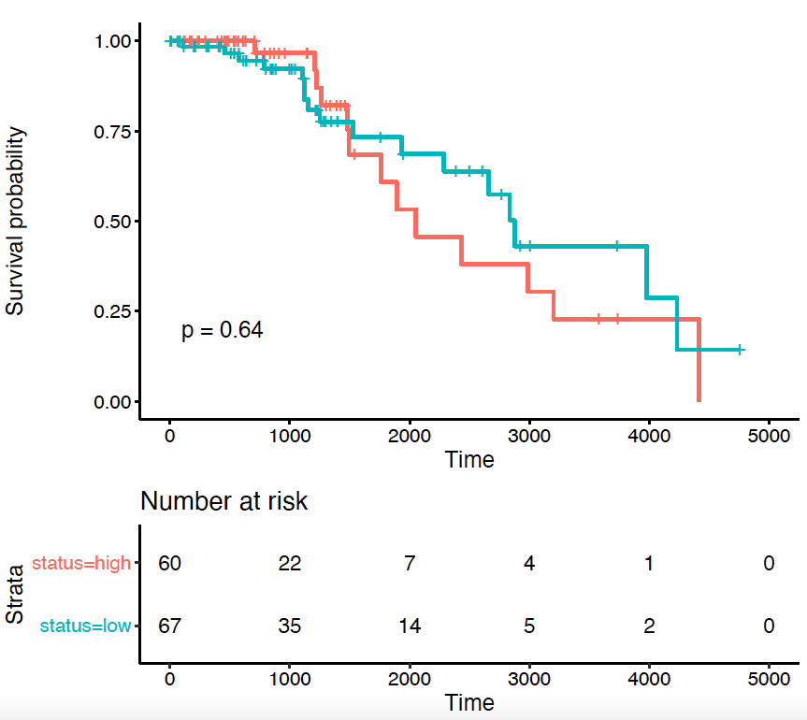
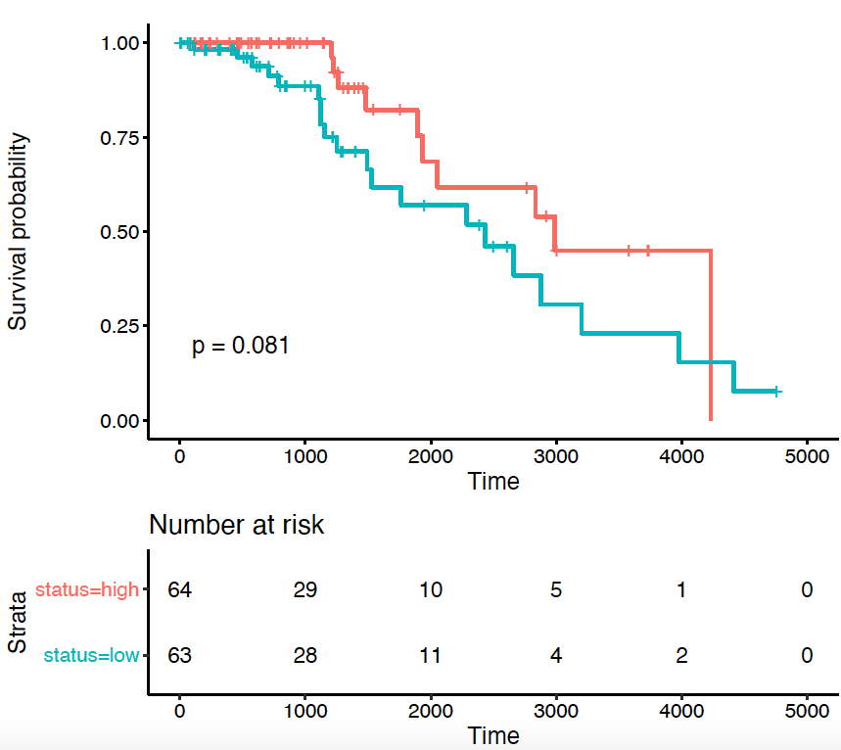
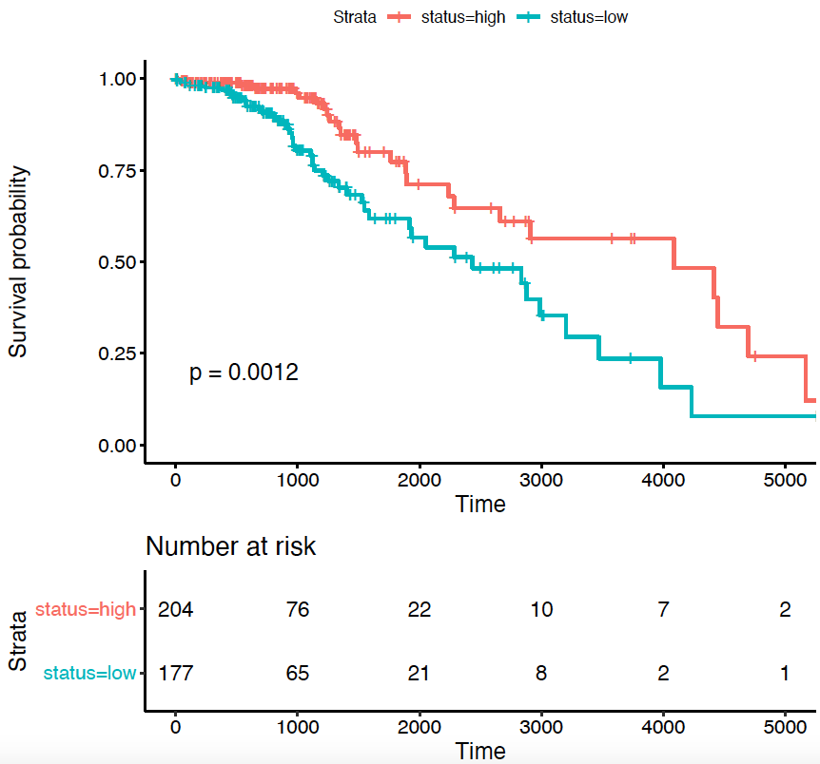
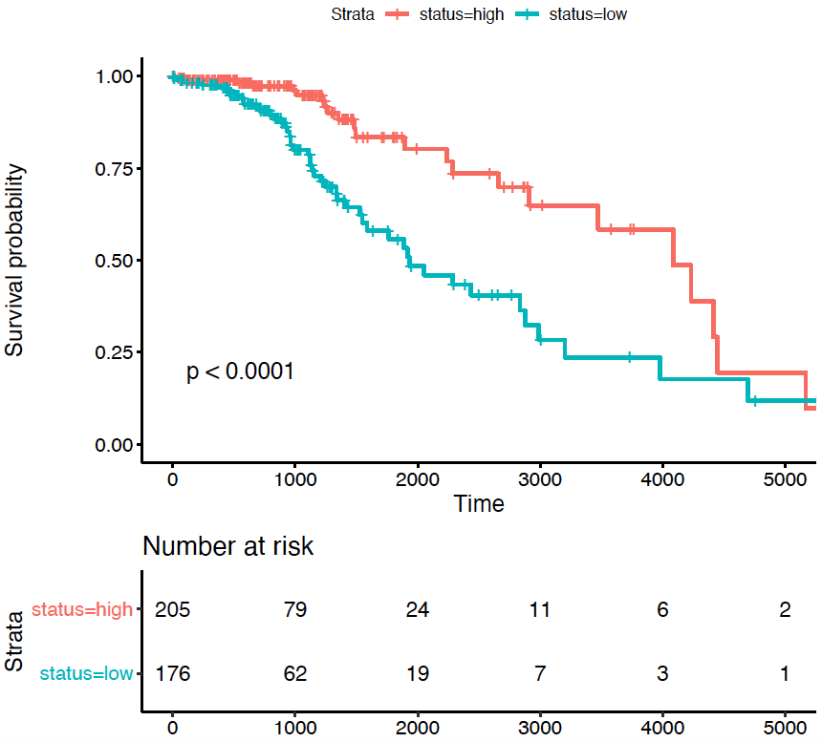
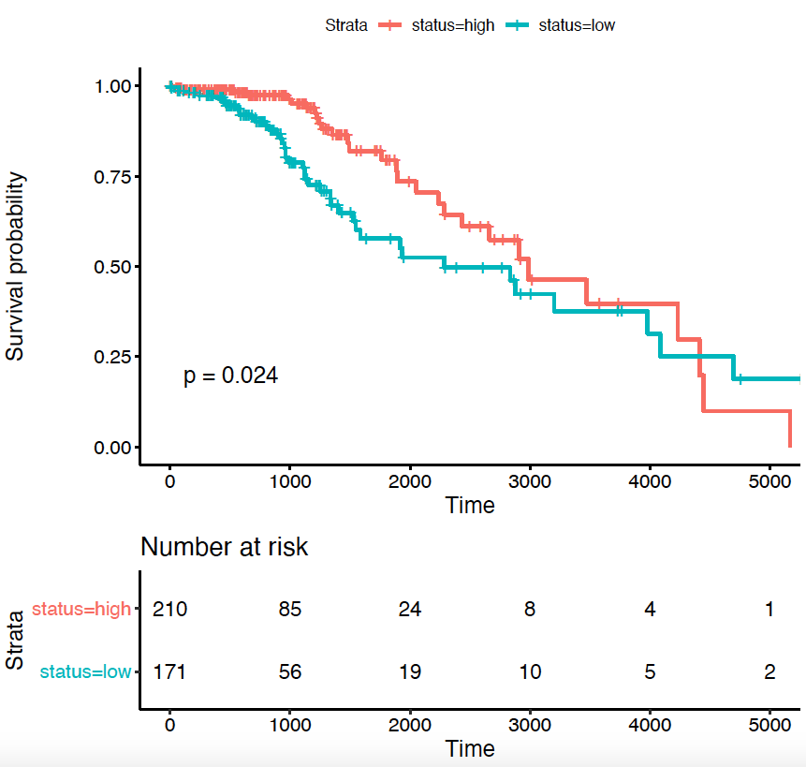
Coxph analysis using the genes DEGs q.value 0.05 and lfc 1 cut.off = 0
0.05
0.01
0.001
UP: 174
Down: 17
UP: 68
Down: 4
LGG
IDH1 + TP53 + ATRX
LGG
IDH1

Slide 22
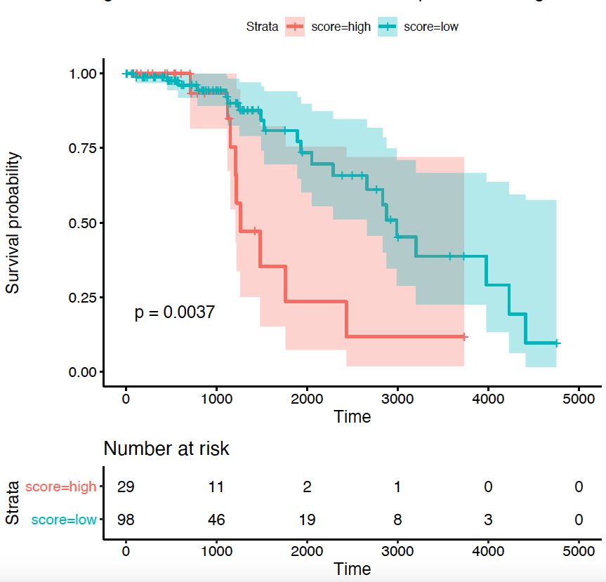
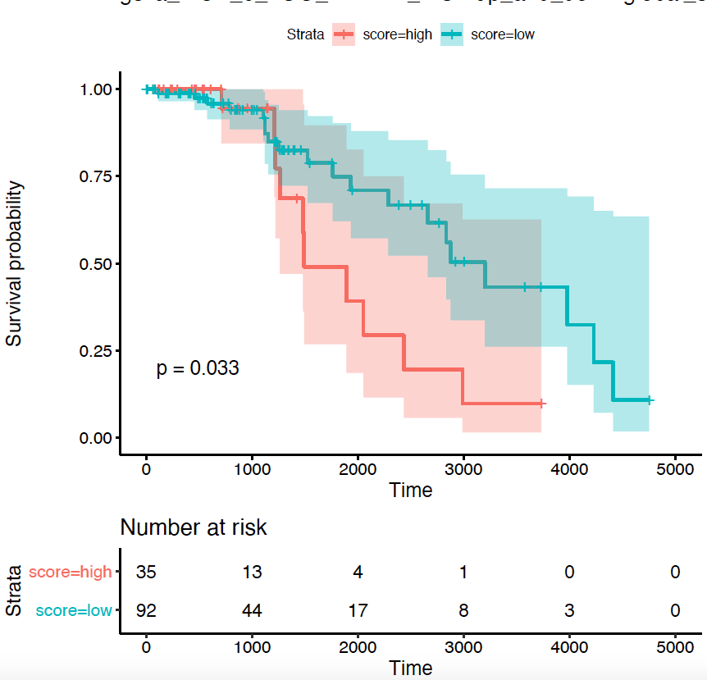
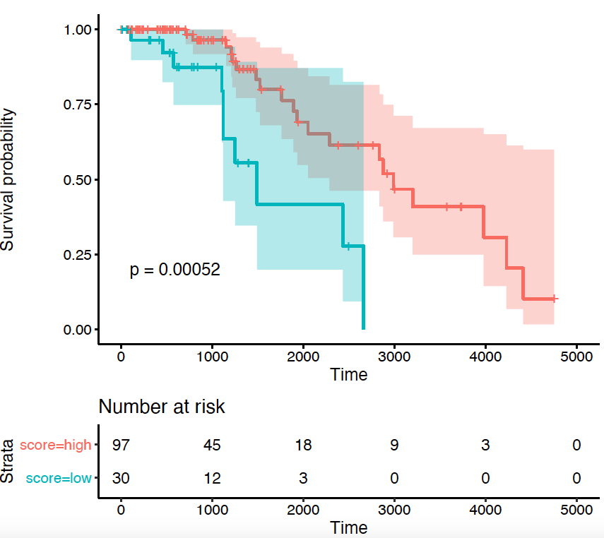
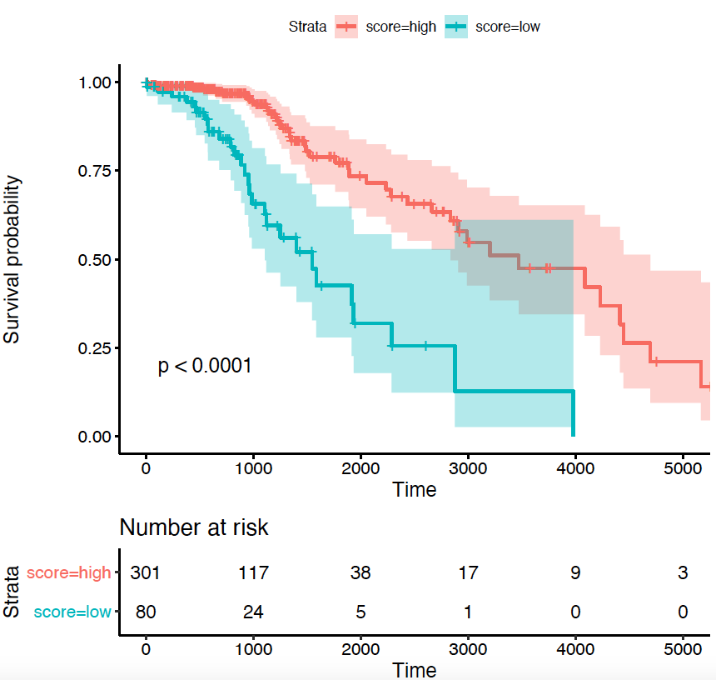
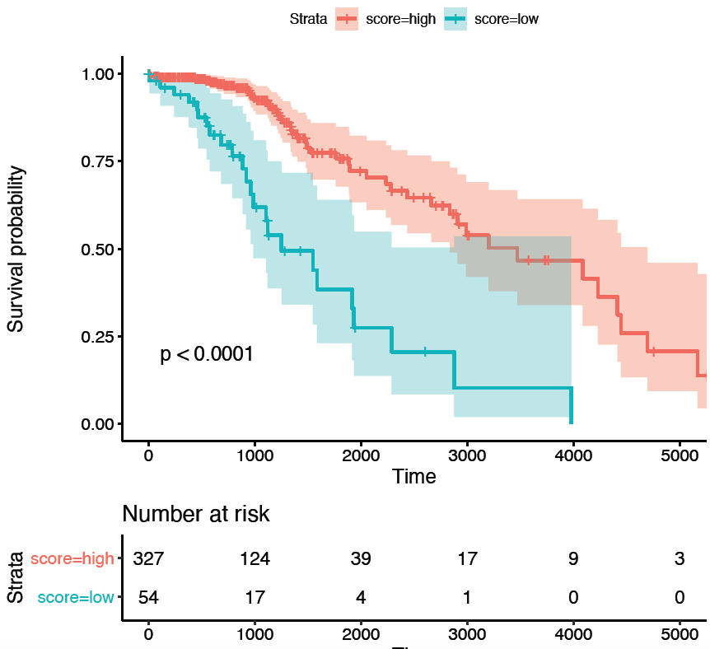
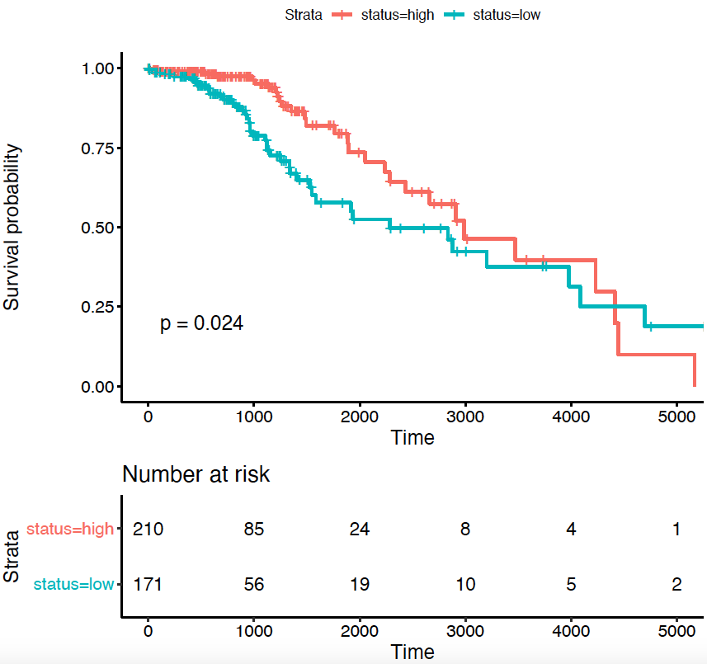
Coxph analysis using the genes DEGs q.value 0.05 and lfc 1
(automatic thr)
0.05
0.01
0.001
UP: 174
Down: 17
C.O. = 0.4
UP: 68
Down: 4
C.O. = 0.35
LGG
IDH1 + TP53 + ATRX
LGG
IDH1

Slide 23
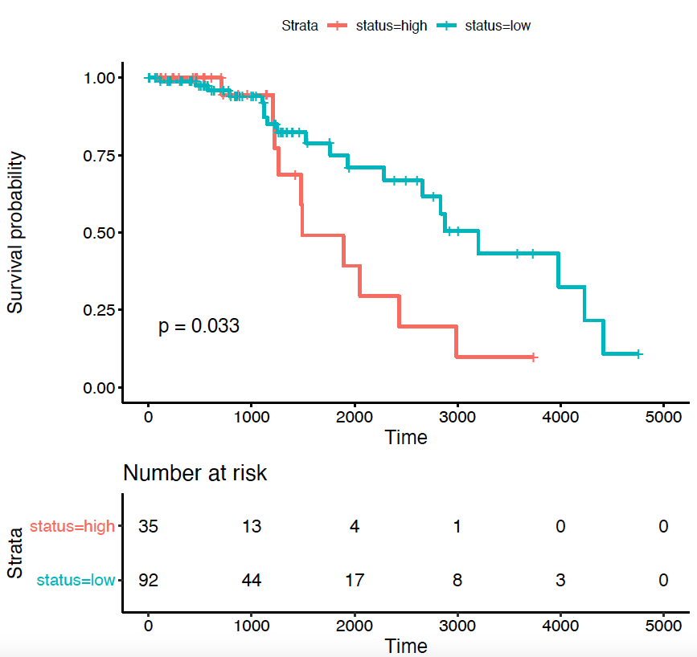
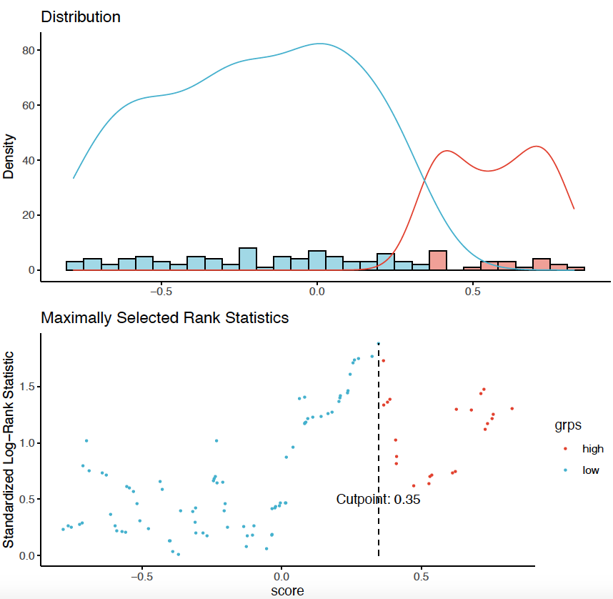
Coxph analysis using the genes DEGs q.value 0.05 and lfc 1 cut.off = 0.4
Solution 1
q.value DEGs = 0.05
LFC DEGs = 1
p.value coxph = 0.01
C.O. = 0.35
UP: 68
Down: 4
C.O. = 0.35
LGG
IDH1 + TP53 + ATRX

Slide 24
CompC1AvsC1B
q.value 0.05 and lfc 2

Slide 25
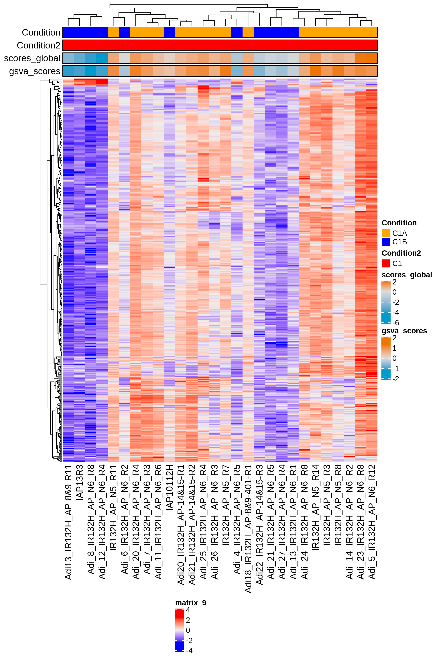
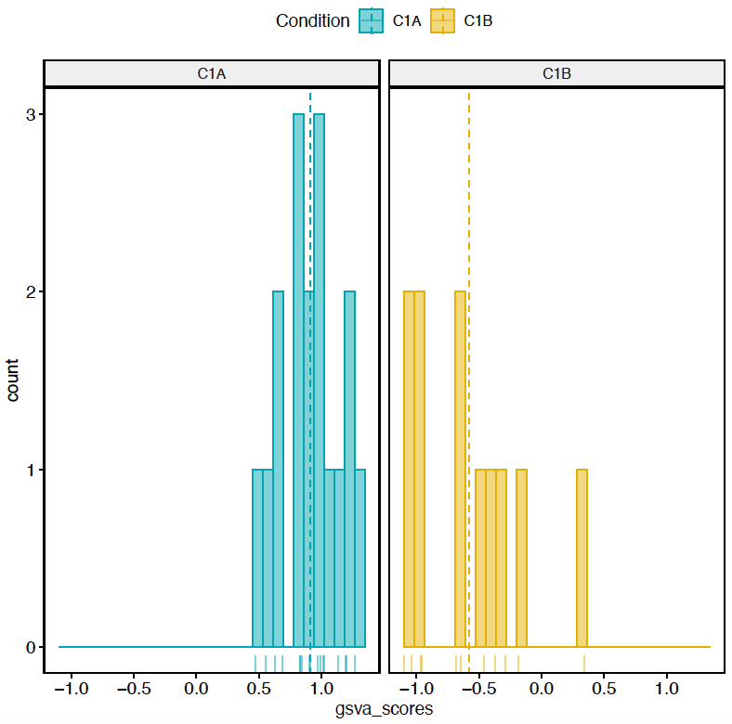
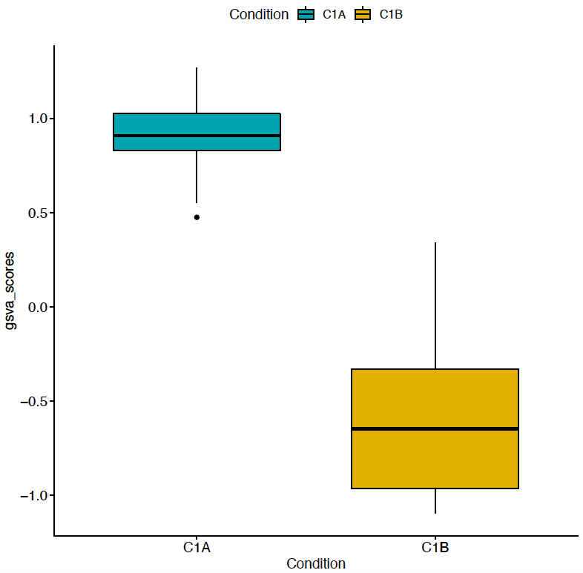
n. genes = 384

Slide 26


CompC1AvsC1B q.value 0.05 and lfc 2
n. genes = 337

Slide 27

LGG q.value 0.05 and lfc 2

Slide 28

CompC1AvsC1B LGG IDH+ ATRX + TP53 q.value 0.05 and lfc 2

Slide 29






CompC1AvsC1B
Coxph analysis using the genes DEGs q.value 0.05 and lfc 2 cut.off = 0
0.05
0.01
0.001
UP: 45
Down: 0
UP: 17
Down: 0
LGG
IDH1 + TP53 + ATRX
LGG
IDH1

Slide 30






CompC1AvsC1B Coxph analysis using the genes DEGs q.value 0.05 and lfc 2
(automatic thr)
0.05
0.01
0.001
LGG
IDH1 + TP53 + ATRX
LGG
IDH1

Slide 31
CompC1AvsC1B
Coxph analysis using the genes DEGs q.value 0.05 and lfc 2
Solution 2 (***)
q.value DEGs = 0.05
LFC DEGs= 2
C.O. = 0
p. value coxph = 0.01
LGG
IDH1 + TP53 + ATRX

Slide 32
TCGA-R8-A6YH
clin.lgg <- GDCquery_clinic("TCGA-LGG", "clinical")
features_to_select<-c("submitter_id","days_to_death","days_to_last_follow_up","vital_status")
clin.lgg2<-clin.lgg[,colnames(clin.lgg)%in%features_to_select]
clin.lgg[grep(clin.lgg$ submitter_id,pattern="TCGA-R8-A6YH"),]
No sample

